Slide 1




Market opportunities for the FAsT TV concept
November 2022
IMPETUS RESEARCH | November 2022
Notes:
Image: https://www.slidemembers.com/en_US/view/PPT-Templates/media-simple-powerpoint-template-design-10995

Slide 2


Background
The FAsT (Free Ad-supported TV) solution that is practically a linear TV-solution in digital space started from a low basis in the United States and has been dynamically growing ever since. Our three-phase research explores how such a service may be received by residential users and advertisers upon its entering the Hungarian market. Our research is based on the following elements:
01
Focus group discussions (pp 5-29)
Since the solution is absolutely unknown to consumers, it has been important to collect initial insights into the opinions on the concept and to test comprehension of the concept briefing.
Research overview
2
02
Online questionnaires (pp 30-81)
A quantitative study has been conducted to measure current consumer habits potentially influencing expected demand and attraction of the concept.
03
Expert interviews (pp 82-112)
3
Since the concept will be fully advertising-financed, it is worth knowing the first impression of agency experts on the new tool’s outlooks on the advertising market.

Slide 3
Major findings I.
The respective chapters written on the 3 research phases detail the outcome of each phase. In the below integrated summary, we have collected the major findings concerning the concept.
CONSUMERS:
Due to its being free, the potential new service is supposed to have good chances on the Hungarian market. Though users do not envisage to cancel the services they currently use (cable TV, SVOD), they would extend their service portfolio with this new addition and would also actively use provided they find the programme it airs enjoyable. Based on our potential estimate, even half of the target group may register for the service and its long-term role depends on the content broadcast.
In terms of technology, the use would mean no problem for the majority of respondents, because many of them have been already using SVOD services. Thus, those who are interested in the service accept that the use thereof is tied to mandatory registration.
The fact that content is mainly made of non-fresh programmes does not seem to be a huge problem either, as the overwhelming majority of consumers used to rewatch formerly seen content.
The emergence of such a service is not supposed to increase the total time spent viewing content. Viewers believe that the time spent on the new service would decrease the time spent watching classic linear channels. Even though nearly 100 channels are available for them, viewers say they often cannot find programme to their liking. Thus, many of them are likely to be happy with an increase in the number of channels.
Ad-avoidance, in return, could be massive because nearly 70 per cent of the target group told that they largely refrain from watching advertisements. Ad-avoidance may be decreased by standardly inserting only few advertisements in each block.

Slide 4
Major findings - II.
ADVERTISERS:
Experts say that advertisers are principally attracted by media where they can reach their target audience. So if this service is highly used by consumers, advertising market outlook for it is bright. Depending on the method of advertising applied, it may be built in media plans provided it has a viewership of tens or hundreds of thousands. At the earliest when programmatic sales become available. Experts consider direct sales through sales houses a bit bumpier of a ride.
In terms of media planning and sales, they see the platform as digital media (online video) and based on its features and the envisaged viewing habits, they regard it rather as television.
This duality also occurs in relation to the competition on the market. In terms of media consumption, the new service can mainly compete in prime-time periods and with long-tail channels. Here rather daytime, long ATS (viewing time) and not overly focused viewing situation is envisaged. From an advertising point of view, the service is envisaged to primarily run for digital budgets. It is because TV budgets are quite fixed as a result of annual deals, which is why those cannot really be adjusted.
The new service as a tool may have the advantage that it is envisaged mostly to be watched on large screen which allows for higher-quality ad display in contrast to other online videos, and that it is supposed to provide additional contacts (for free) (in case of families watching TV together) if contact-based selling is carried out.
Considering its advertising value, experts position the service above YouTube videos, but below SVOD ads that are expected to enter the market. Opinions were divided on the new service’s value as against adverts running on current digital platforms by RTL and TV2, but experts rated it lower than those (mainly because of the more premium programme environment on these digital platforms).
The opportunity of advertising in expressly short blocks would be highly appreciated.

Slide 5
01
Qualitative online FGD research results
FAsT TV concept

Slide 6
Summary
The abundance in cinematic content and the ever widening basis of channels available make viewers talk increasingly about viewing content instead of viewing platforms. It is live broadcast that increasingly represent the major advantage of linear TV. Consumption of SVOD content is a widespread phenomenon.
Viewers clearly compare FAsT TV to linear TV.
They can quite easily and unanimously identify both its advantages and disadvantages. The former include free access to the service, thematic content and its availability on any device. It represents additional advantages that it renders popular old programmes rewatchable and that the wide programme offering contains enjoyable programmes for sure.
A major disadvantage is the appearance or advertisements. On top of that, the lack of fresh content, and non-searchable content were mentioned.
All in all, the concept is not really seen as a novelty. Its being free of charge means no particular attraction because viewers find their current cable TV costs affordable, even though the latest economic difficulties may somewhat change this.
The main attraction of the concept is supposed to be the content it airs. Content found attractive by viewers that is broadcast in multiple channels continuously can result in massive consumption. Besides, first user experience may not be let unnoticed either. It is expected to be seamless and user-friendly.
The majority would not cancel any media services they currently use, but since it is for free, they would add this service to their portfolio and would actively use it if they found the content it airs enjoyable.
Not even mandatory registration prevents prospects from subscribing to it.
6

Slide 7
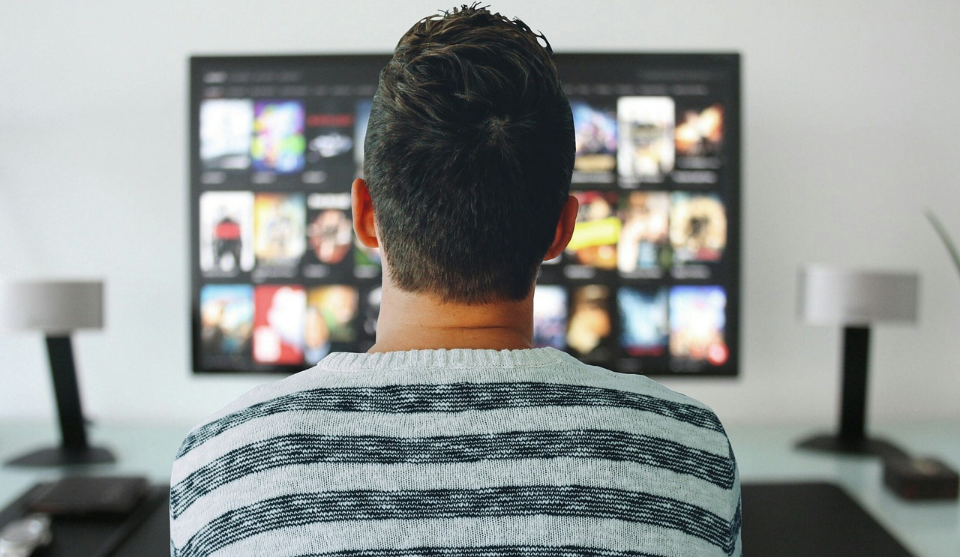
Research parameters

Slide 8

Research parameters
Background
Qualitative Phase : online focus group discussions
A three stage consumer research was carried out to access the potential of FAST TV model in Hungary.
The current report is related to the qualitative phase findings, focussing on the acceptance of the FAST TV concept, and envisaged usage of the solution
A short list of key findings on current usage habits is also summarized, that are extensively measured in the quantitative phase .
.
.
Target group
Users of subscription and/or free video streaming services, video sharing sites and social media to access video content, aged 18-59 ys, male and females
Sample
4 standard length online groups (90-100 minutes long each) on Zoom platform
6 participants per group, n=24
Groups split by age and by usage frequency of streaming
  Age brackets: 18-35 ys vs 36-59 ys
  Heavy users: use video streaming on daily basis or several times a week
  Light users: use video streaming maximum a couple of times times a week
  Fieldwork: October 4-6th, 2022

Slide 9
Current usage habits

Slide 10
Usage patterns and tendencies
Multichannel usage
Linear TV subscription is seen as a basic solution for households, it is subscribed even if it is less often used and they claim a declining tendency in their own usage overall. Subscriptions to linear are also often part of a bundle package – making other media/communication and phone costs a better value overall.
As a result of having numerous possibilities to access video contents online, the practice of „watching channels” is fading to watching contents instead.
When asked about their last linear TV usage, typical answers were either sports events (football, Formula1), news or channel series ad quiz shows
At least one SVOD is available in the household for majority, regardless of heavy or light usage of streaming. Heavy users may have multiple subscriptions (Netflix, Amazon Prime, HBO Max/Go, Disney+, Apple TV).
Minority of respondents -typically light users- shared subscription or may got access to SVOD from friends/family (Netflix)
Usage of mindigTV and mediaklikk.hu was rather low across the sample
Paying a certain amount monthly for media/entertainment was not seen burdening, and seen as part of regular overheads. As benchmarks, they consider the price of movie ticket prices. Amounts spent on media content are typically treated as overhead costs, just like internet subscription costs. There is no "media" budget in the family budget.
It is expected that users will start rationalization of their media costs – with budgets becoming tight due to high inflation.
„…If I cancelled the subscription, phone and internet costs would be higher, so it is not worth cancelling it, even if one des not use it” Male, 18-35yo, light user
I subscribed to Netflix when it started, at a good price. I considered the price of a cinema ticket, and if it covers it, that’s already a good deal, worth fpr me” Male, 18-35yo, light user
„We have just realized that the Apple TV charges are on the bills, it never occured to us. But we will opt out, it is unnecessary” Female, 35-59 yo, heavy user
„

Slide 11
SVOD perceived advantages
Ad free and consuming content on own terms are the key benefits
Benefits - from customer perspective
Advertising free – relevant for all
Can watch selected movies any time, anyhow, at any pace - more relevant for heavy users
The further benefits are more enjoyed by heavy users
Flexibility – E.g. Can stop/restart any time; mark status
Recommendations are pretty relevant „The algorythm has learnt me well”
Useful functions like most popular choices, „last chance” notifications
Simple processes of registration, subscription on monthly base and opt-out
Very extensive „library” to choose from
Continuously introduced fresh content (Latest movies, new series)
At the same time easy access to earlier content (Brush up memories, „nostalgia”, Favourites)

Slide 12
SVOD perceived frustrations
Potential frustrations with SVOD
„…I decided not to subscribe to Netflix. For 2500 they do not offer too much. That is my IPTV and data costs for a month, it is OK. They also play a lot with putting up old content, and remove others. The real better service is too expensive at Netflix. The 2500 HUF is a base, but the quality is low, on TV sets that are typical today. HBO Max is 1990, and starts giving you HD in the first place” Male, 18-35yo, heavy user
Craks in the system - customer re-considers their subscription, opts-out, and/or modifies choice.
Premium contents a can get too expensive if one wants to maximize the experience
HD is not available in basic packages - No HD may be less enjoyable with 4K/8K TV’s and larger screen TV sets
Content becomes too predictable, new contents are too much the same as previous contents (typically a Netflix-related critique)
„Feel like have seen everything” – customer become exhausted (Eg. Disney +)
Rumours of adding advertising/Sponsored content to SVOD services. Paying for ads feels highly uncomfortable and frustrating
Customers may realize they are hardly using a certain service, but they still keep paying the account – just in case. After a certain time it becomes obvious that the subscription is truly unnecessary
Expectations /promises are high but reality does not meet. (Typically when Netflix started – a few respondents opted out, but later went back based on WoM)

Slide 13
Evaluation of FAsT TV concept

Slide 14
FAsT TV CONCEPT
FAsT TV is more like a linear TV
Overall positives of the concept
Overall negatives of the concept
Functional
Free/No cost
Potentially wide range of thematic, specific channels
Mobile, available on APP too
Emotional
There are no commitment that need to be made, no loyalty
Older series are expected to be available
Can be used as „background TV” - just being surrounded with a favourite topic channel on
Likely to find genres/topics that are personally relevant and/or inspiring amongst the numerous channels it will offer
Functional
Ads are present - there’s close to zero tolerance especially amongst heavy VOD users. „It is exactly what we do not like in TV”
Linear stream /preset stream
No live content - this would be important for sports and news contents
„It is like TV” (for heavy streaming users it is a barrier), there’s nothing new in it
Yet unknown quality of content
Yet unknown technical quality (resolution? )
Emotional
Worries that the advertising blocks are too disturbing - too frequent advertising slots, too long sessions, „slicing up” and ruining the viewer’s experience

Slide 15
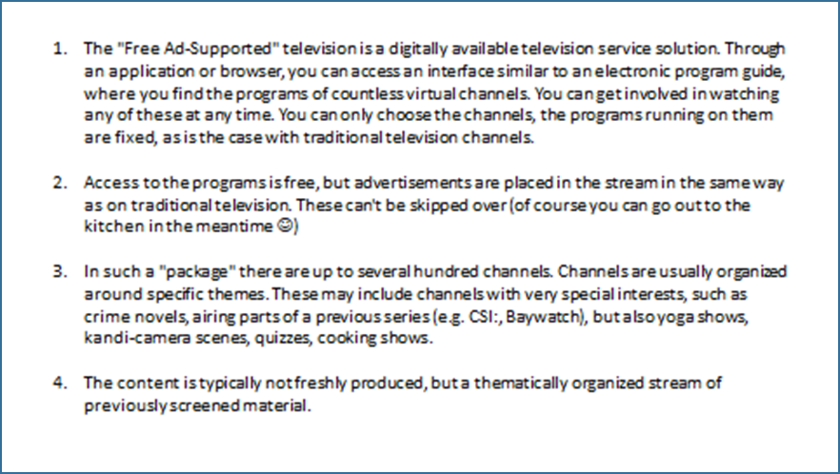
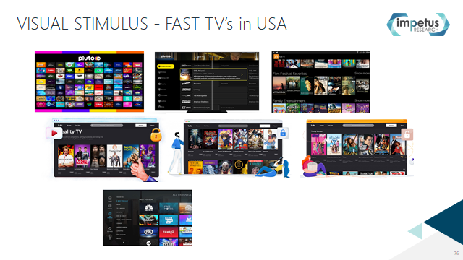
Comprehension of FAsT TV idea
Visual information boosts understanding and positively influences acceptance
The concept was slightly re-phrased after the first groups, for better understanding of diversity/abundance of channels.
In most groups the concept seemed better comprehended and elevated into more positive framing when it was supported with visuals examples of USA FAST TV solutions. ( also see in Appendix for exact images shown)
This indicates that the verbal description supported the cognitive understanding and emphasized for participants similarities to linear TV more. It was often mentioned that it is not a „novelty” solution.
Visual illustration put the FAST TV features in context , and helped comprehension of „countless virtual channels” and sense of „choice” .Visuals about the platforms created a more relatable emotional understanding, especially emphasizing the freedom of channel choice
This indicates, that when introducing FAST TV solutions, it will be important to communicate the experience of the solution for the customer perspective,
  - visuals that emphasize to diversity in channel choice, and illustrates the platform itself, the registration, possible profiling and thematic structure, to provide a good emotional, relatable grounding to FAST TV

Slide 16
The concept intro – the core idea of FAST TV
Not seen as a radically new model
Application or browser availability is seen positive and relatable in the context
They are accessing a lot of video contents on webpages and platforms (like YouTube, Videa, Vimeo, social media etc.).Application usage is more typical to younger audiences.
It is also claimed, that APPs are more related to smartphone device. Watching video contents „as TV” is more comfortable on large screen TV sets or larger monitors. Especially when watching videos in social circle of family or friends.
Fixed programme run was the feature that made FAST TV linear-TV like. As expected, fixed programme feature was typically rejected by heavy SVOD users in general. VOD services are exactly delivering what they want, on demand.
Racionalised dislike with unfitting lifestyle , too - i.e. less planned or calculable activities, that not allow them to regularly commit themselves to a certain time.
More openness was shown amongst light streaming users. Some of them have regular routine with linear TV, as either a background noise TV or as a typical daily activity watching linear TV content rather than OD.
Overall the intro paragraph has three key outtakes for the customers: APP/Browser accessibility, promise of „countless channels”, and fixed programme run.
At this point none of these are perceived as a great novelty., not stirring high attraction (few recalled e.g. VodafoneTV or MindigTV as similar services)
„…I have a very irregular working pattern, I do not believe this concept is for people like me. This linearity is not for me. But I trust that they mention a very wide range of channels, so I believe there could be a few that are potentially interesting for me personally” Male, 18-35 yo, light user
„It may be similar to Vodafone TV…It feels like TV for me, I do not like it too much, because of the fixed stream” Female, 18-35 yo light user
„I do not see what is novelty about it?” Male, 36-59 yo, light user

Slide 17
Advertising supported
Having to tolerate advertising is the price paid for „free”
Free content is understood to be supported by advertising, as they expected it.
Free content indicates some compromises and limitations for them
  like no HD resolution, content quality or narrow choice..
Younger respondents also mentioned that „free” is often provided at the cost of paying with personal data, too
Having free access to a minimal, basic ‚package” of information is seen important for the lower Socio-economical status families.
Some are very strong rejecters of ads in streams – this is a top reason why they switch to SVOD solutions.
Main concerns about ads are both functional and emotional, with skew to negative emotional.
They’d like to minimize the negatives of ad presence. While some expectations about ad placement may be unrealistic, they well indicate areas of frustration with ads
They would like to learn more about the ad slots in the stream to state whether they are tolerable or not.
  How ads are distributed/positioned in the stream? Ad slots in-between titles are more accepted than ad slots slicing up content, ruining the experience.
  Less frequent lengthier slots are more tolerable than frequent shorter slots. Ad slots that are too long are frustrating in general, though.
  Single ads should not be too much repeated - perceived by consumer to be hateful, counter-productive
  Ad slots should not be system high volume- it is shocking, distressing in some situations (having fallen asleep with TV on/small kids around etc.)
„…If not putting ads into the films, it will then place it around the platform. I’d only be interested if ads are not cutting the films, but placed in-between titles…although I do not see why I’d be motivated to watch films like that, when I have a subscription, where I can watch my choices as and when I want, ad –free.” Female, 35-59 yo, heavy user
This will make the one and half hour long film three hours long to watch…I cannot do that… „Female, 35-59 yo heavy user

Slide 18
Thematized, specific channels, expected contents
As a novelty feature, thematized channels can be a strong asset of FAST TV
The thematized, specific themed channels are attractive and seen as a novelty feature.
Clear thematization, well structured presentation and search function will be important aspects with such extensive content,
The given examples were understood, and several other genres were suggested to be included in the offer, e.g:
  Children’s contents - families with small children need to have an instant solution of entertaining children either at home or on the go. Also, adults enjoy classic animation.
  Comedy, humour
  Documentaries (nature, history, crime)
  Iconic series, iconic actors – although these are likely to be available on other platforms too, they say.
Related to sports contents we need to emphasize that lack of live sports is a strong negative differentiation point – need reframing in their minds.
  Sports like golf, sailing, poker that we probed were mostly irrelevant, culturally distant
  Culturally relevant sports like soccer related themes could still be included in other genres (sports history, historical games).
Light streaming users mentioned more detailed topics, fine-tuned to personal interests (see Appendices)
Feature films, thrillers and drama series are usually consumed from SVOD , or other free VOD streaming. Above them there are some genres that would raise their higher interest, but qualitative data in this aspects are less informative.
In their suggestion, lifestyle related contents were also mentioned. Younger groups both suggested „home workout - a topic that is likely to be consumed in APPS or Social Media videos, not on TV or VOD. Other lifestyle related topics were mentioned too like Pets/ Home DIY/ creative DIY/Gardening across the sample
As for local & international content ,they were open for both content type.
Foreign language content was mentioned to be important for learning/practicing languages, they’d like to have this possibility in FAST TV.
„…I’d give it 2-3 weeks or so to explore the platform and learn about what’s behind the genres, but I am not a frequent user, so it is like a week for others.” Male, 35-59 yo light user
„For me it is a bit strange and is questionable whether I could stay just watching a single genre for hours on a regular basis.” Male, 35-59 yo light user

Slide 19
Non-fresh content
Can even be an asset with well selected content that is brushed up from time to time
„The older content for me is not a disadvantage. I have favourites, old time films, that I like to watch repeatedly” Female 35-59 yo, light user
„It depends on what rights will the channel gain, what contents will be available” Male 35-59 yo, light user
„I can imagine we organize a special party watching old Baywatch…these retro events are gaining interest lately” Male 18-35 yo, light user
Interestingly, even in case of premium streaming subscriptions (SVOD), customers like to repeatedly watch a series or a movie to brush up their memories, or, simply to enjoy again their favourite series/films
The non-fresh content is not seen as an alarming disadvantage in general
Content may be not fresh, but should not be outdated.
It is more seen as a possibility to access content that one can otherwise have difficulties to find.
With FAST TV one will be able to search for topics and channels close to their interest and may possibly even find new areas of interest
Fresh content and focus on „new” content is more related to SVOD, particularly Netflix and HBO Max – it is a typical feature defining the SVOD model.
On linear TV „freshness” is felt less in focus when it comes to entertaining contents
It is expected however, that new titles are regularly added/extended to the channels - to avoid wear-out and impression of low, not sufficient variety within a channel

Slide 20
Envisaged usage situations
Less frequent users of streaming services could envisage more usage situations
As a background thematic „noise” – one could choose a topic that is personally relevant . The envisaged situation may even make the viewer pause to sit and follow the stream for a while from time to time. In such modes the role of the FAST TV is accompanying the situation and the activity (e.g. while cleaning, cooking, doing other housework). They’ envisage this kind of usage on any device, from smartphone through laptop or smart TV screen
Classic weekend/end of the day watching films together with partner/family –overall minority of the sample
Usage in holiday homes/weekend homes where there is no service ( no cable/ no satellite TV), one could use this solution to get some entertainment. Typically they’d use a tablet, laptop.
During longer journeys one may decide to watch a favourite channel with FAST TV., on smartphone or tablet
In social institutions and settings: old people’s homes, hospitals, waiting rooms, beauty salons, pubs – a fitting genre or content is envisaged to be suitable.
In households with small child/ren who often watch content . One has not to worry what is coming up (e.g on YouTube), the content flow can be better controlled (based on the schedule), and it is hassle free.
Can envisage special „fun days” with friends, themed around a certain title ( e.g Baywatch retro party), when watch episodes together (younger/less frequent streaming user). For this, they’d envisage a larger screen (smart TV, larger sized monitor) device
While working/studying using a laptop, some would embed minimum size FAST TV in the screen , as „multitasking” stimulus
„…

Slide 21
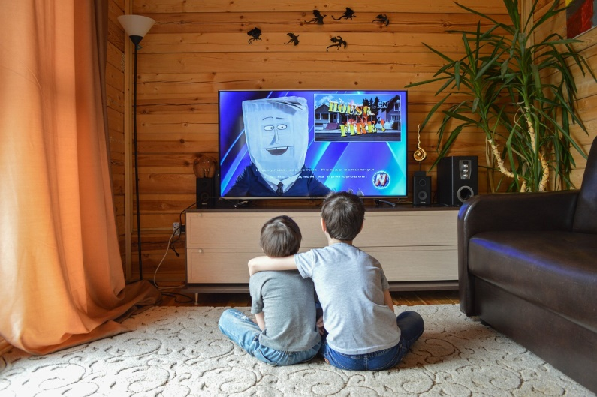
Envisaged target audiences
Less frequent users of streaming services are seen the main envisaged user group
Envisaged core target is light or non users of SVOD - having less or no SVOD subscriptions at all
Socio-economic and other demographic aspects are believed to be important
  Families with young children – due to children dedicated content is taken for granted
  Elderly, pensioners
  Living in the countryside or rural areas
  Lower socio-economic status households
Lifestyle may also play a role
  Less active & busy audiences
  Not on strict daily schedules
  Can organize their days around fixed timings of the stream
„…

Slide 22
How is it expected to affect current habits?
More relevant for current linear TV users
Minority of the qualitative sample claimed boldly that this model is so distant for them that it is not likely to give a try. – they cannot see its place in their lives
Majority of those who are at least minimally interested claim that Fast TV is going to be included in their portfolio rather than replace a specific solution.
If any, the current traditional/linear TV subscription may be replaced – however it was claimed that often they buy communication and TV services in bundle packages, at rather good rates, and often with unlimited data - which means giving up their TV subscription would results in higher communication costs – which they want to avoid.
As the solution is free, it is likely that majority will not feel reluctant to download the app and have a look, or at least set themselves to a „trial period” (anything from a couple of hours to a month) before they decide it is a solution for them/not
At the focus groups, current heavy SVOD user groups estimated that 5-25% of their current total video consuming screen time could potentially be covered by FAST TV. --Provided that their experiences are positive and their negative preconceptions on ads are not valid.
Light/no users of SVOD envisaged higher percentage of their screen time dedicated, claiming between 10-70% (!) of their current total times spent watching some video content. Naturally, as a qualitative result, it only indicates a higher opennes amongst light users of streaming,
„…

Slide 23
Onboarding FAST TV
Not keen on registration, and not keen on providing personal info beyond username and e-mail at early exploratory stage
Because of charge free, a very simple onboarding is envisaged, if at all registration is needed. Some even claimed that having to registrate is already an opt-out.
At second thoughts, having to register is reasonable - as it will ensure possibility for personalization in later phases., or ensure eligibility.
The user experience of onboarding should be smooth, fast and simple, and envisaged to ask only username, and an email contact. On the longer term, there is relatively high openness to make settings and profiling
  Expected main benefits of profiling are easier handling of favourite channels, or typically used cca .10 channels
It is also emphasized amongst younger age groups, that „free” means financially free, but one has to „pay” either with having to tolerate ads in blocks or in banners, and/or set programme, and/or with data that can be gained from the viewers (this indicates higher data consciousness amongst younger)
Some respondents of younger age – with more a also envisage some other functions - inspired by SVOD’s functions
  sending reminders of marked titles being streamed
  recommendations of newly appearing titles based on earlier set preferences,
Expect announcement of availability: communication and informative ads are expected when a FAST TV service first commences in Hungary
„bár

Slide 24
FAST TV usage on long term
It is not a breakthrough service yet
Drivers of staying with FAST TV after trial
  It is free, there is no harm in trying/staying
  If customer finds personally relevant 5-10 channels out of 100+ - the diversity is promising to explore
  Content that is less/not easily available in the internet
  Positive first encounters - registration process and early usage experiences
    More frequent streaming users are expected to make faster decision on yes/no, with lower „tolerance” level and shorter trial time
  Positive Word of mouth will help
„All in all, it’s OK as a free service …but overall is not so good” Male 18-35 yo light user

Slide 25
Appendices

Slide 26
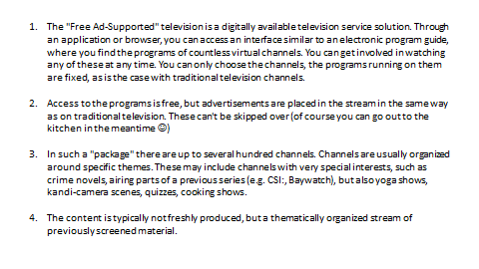
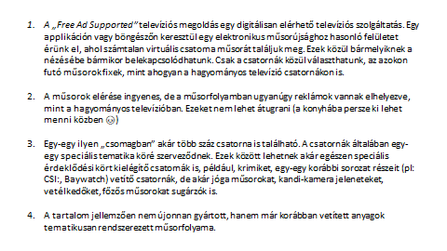
FAST TV CONCEPT
Hungarian version as presented

Slide 27
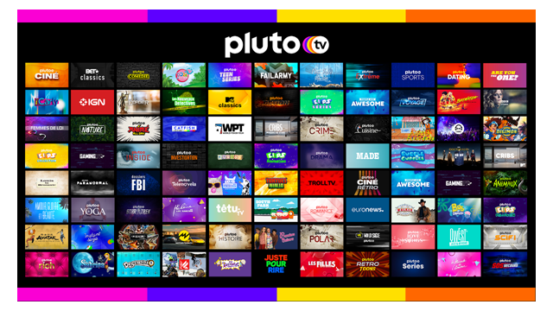
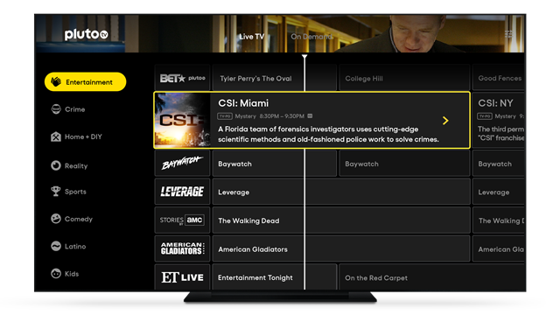
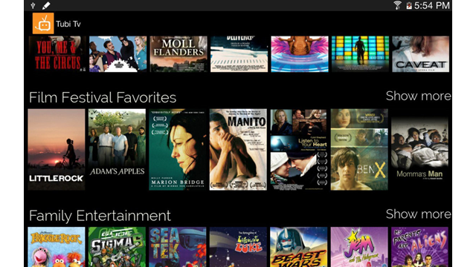
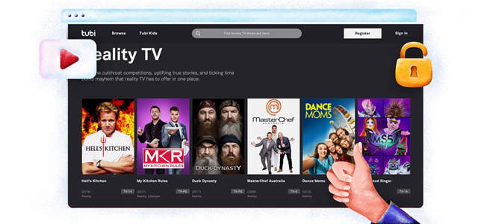
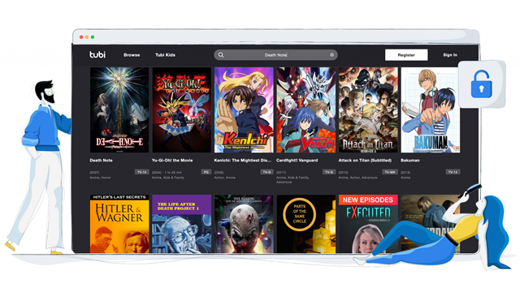
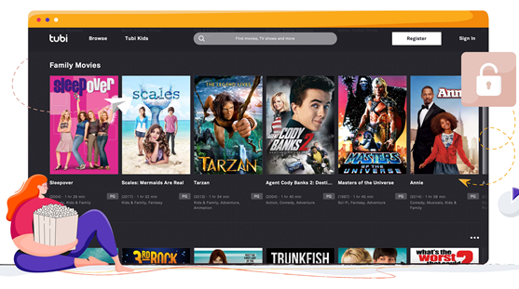
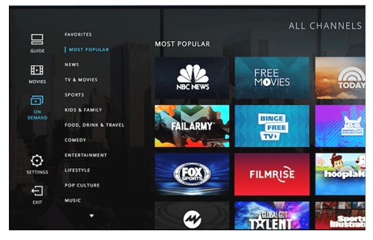
VISUAL STIMULUS - FAST TV’s in USA

Slide 28
Contents proposed by participants
Heavy users
36-59 yo heavy users of streaming
18-35 yo heavy users of streaming
  Comedies (2)
  Ccooking competition/shows(2)
  Horror(2)
  Adventure films
  Retro cinemas, 90s, 80s, 70s and 60s movies (Hungarian and American) (2)
  Concerts
  Sci-fi
  Sit-Coms
  Investigation, crime, real crimes documentaries
  Scientific research
  Family movies
  Costumed films
  Mary Condo
  Household, home décor, household tips, cleaning
  Pet: dogs
  James Bond movies
  Actors’ channel: films related to a particular actor: e.g. Al Pacino
  Retro (2)
  Comedy (3)
  Soccer, Dedicated channel for Soccer European Championships and World Cups (2)
  Sci-fi
  3D printing
  Star Trek
  Women's channels, e.g. beauty, personal care
  Maternity, childcare
  Oldtimer cartoons (e.g. The Lion King (1994))
  Crime
  Documentary
  Biographical channel
  Prison channel
  Cooking channels
  Home workout: personal trainer, traning
  Director’s channel, films of a particular director
  Original language films and series (with subtitles)
  Actors’ channel: films related to a particular actor: e.g. Will Smith

Slide 29
Contents proposed by participants
Light users
36-59 yo light users of streaming
18-35 yo light users of streaming
  Cooking& baking, competitions/shows (2)
  Theatre performances (2)
  digital world, IT related (2)
  Music channels split by genres like jazz, classic, pop/hits (2)
  classic detective stories (80’s)
  Wild animals (2)
  Football, old-time football, about football clubs (2)
  Educational: teaching languages, excel tricks, maths, physics etc – mainly targeted to adults (2)
  Religious content
  History of discoveries
  Biographical films
  Gardening, crop production, horticulture
  „How it is made?” docus
  Creative ideas DIY
  Child care
  Old American movies
  Sports history
  Farming/animal raising
  DIY around the house, like painting and glazing, building a house
  Cars, motor world
  News
  Comedy series
  Cartoons (modern and old)
  Travelling
  Oscar-winner feature fims
  Crime series
  Cartoons
  Cooking shows, contests
  Historical documentaries (2)
  Wild animals
  Science documentaries (2)
  Retro movies (international)
  Humour, Comedy (3)
  Hungarian series (In Good, in Bad – „Jóban rosszban”)
  Foreign series
  Classic, old Hungarian films
  Science fiction movies
  Romantic movies
  Classic tales for children
  Workout, home training videos
  Music channel with clips, concerts, further split to musical genres
  Contests Quiz games
  Talent shows (X-factor, StarInStar)
  real/human story series, eg. It's about us, Golden Life
  Child care, Raising children, child psychology
  Various audio-visual experiences e.g. just landscape with music – to create an atmosphere
  Pets - dogs

Slide 30
02
Consumer research
Online questionnaires
30

Slide 31

1
Background
31
Notes:
Image: https://unsplash.com/photos/VBPzRgd7gfc

Slide 32
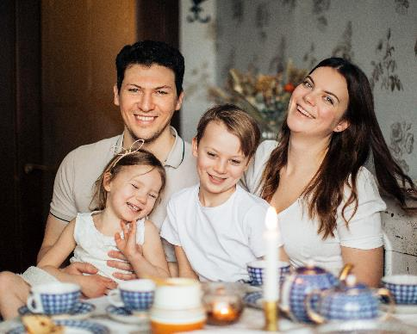


Methodology
Target group
Hungarian residents aged
18-59 with a smart device and unlimited internet access
Methodology
Online survey
Sample size: n=600
Time of data collection
November 7-14 2022
Notes:
Images:
https://www.pexels.com/hu-hu/foto/ferfi-unnep-szeretet-emberek-3807571
https://unsplash.com/photos/Hcfwew744z4
https://unsplash.com/photos/FoKO4DpXamQ

Slide 33
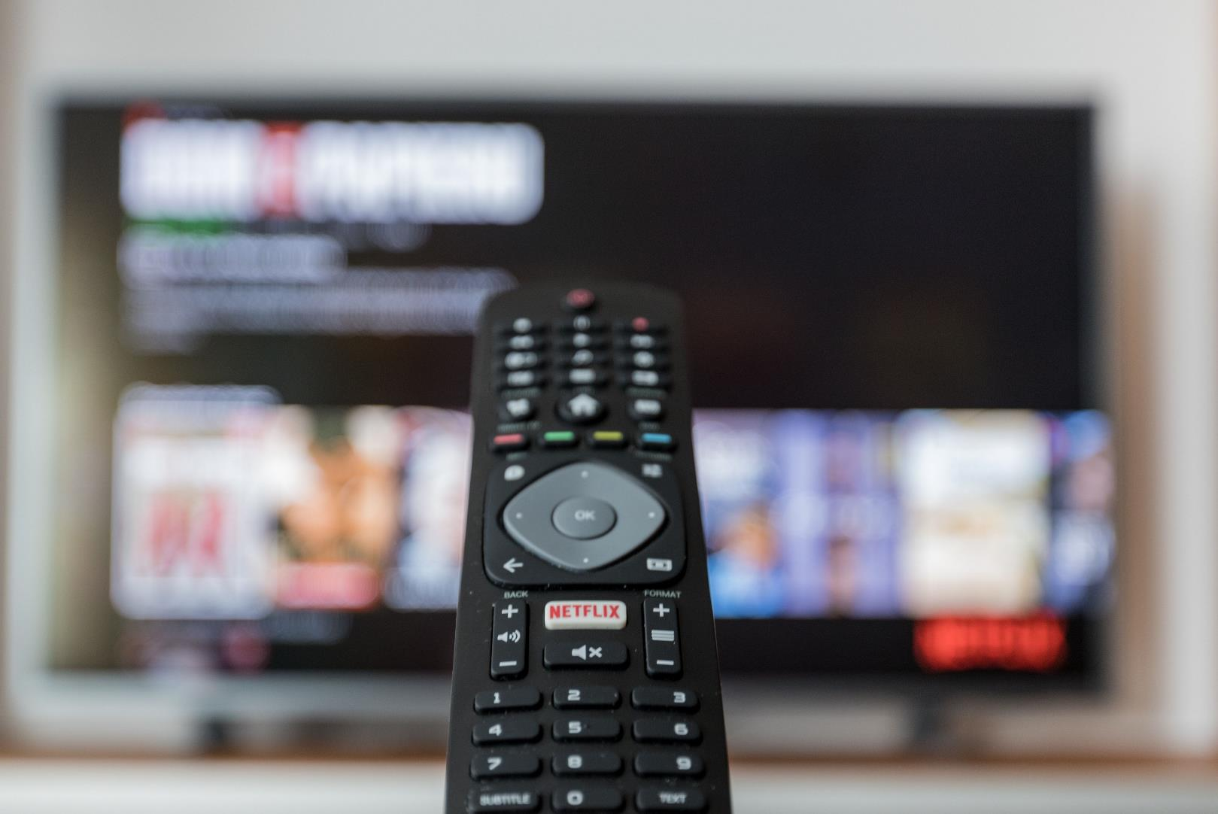
2
Summary
33
Notes:
Image: https://unsplash.com/photos/VBPzRgd7gfc

Slide 34
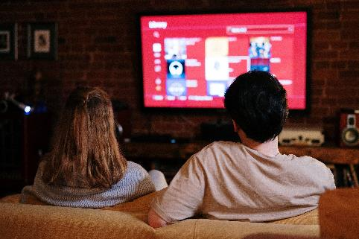
Summary I. - TV-viewing habits
The majority of households (94 per cent) have a television set or a monitor also used for watching TV. Almost each one of them (93 per cent) has a TV subscription, most of which are cable TV subscriptions (69 per cent).
Subscriptions usually include 98 channels with one-seventh of them (15 per cent) including fewer than 50, just under a third (30 per cent) having 50-99, a good third (37 per cent) containing 100-149 and one-sixth (17 per cent) having even more than that. On average, viewers used to switch between 19 channels in order to find the right programme, with two-thirds (67 per cent) watching 15 or fewer channels to this end. That is that they, on average, watch every fifth channel while zapping between channels.
Households usually have two TV sets, and the more members a household has the more TV sets they own. TV sets are mostly used (51 per cent) by the family for joint entertainment.
Two-thirds of users (from among those having more than one TV sets in the household) expressly choose the household’s main TV set for its spectacular image quality.
A good half (56 per cent) of households have a subscription for a streaming service, with most of them having picked Netflix. Every seventh household has a YouTube Premium subscription, while every sixth respondent aged 18-59 has recently bought access to specific content (with most having selected Google TV.
Half of the target group watches classic linear TV, while one third views YouTube, another half prefers streaming and below one-tenth watches online programmes. In classic linear TV, news and educational programmes are the most popular and broadly watched, while YouTube is mainly used for listening to music (at least from from among classic content) and streaming is used for viewing series and feature films.
A third of TV subscribers who had previously cancelled their TV subscriptions did so for not having found enjoyable programmes, while another third disliked advertising. More than half of former subscribers who opted out from streaming did not watch streams and a sixth did not find any content to their liking.
Streaming services are mainly subscribed to for the wide range of programmes they offer and their being free from advertising.
Notes:
Image: https://www.pexels.com/hu-hu/foto/par-szeretet-ules-este-4009409/

Slide 35
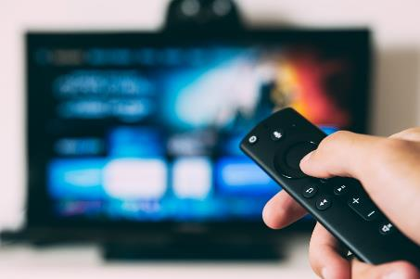
Summary II. - TV and advertising viewing habits
Handling of the (overwhelming) majority of subscribed services is found easy.
No users, not even those having no subscription do find the price of streaming services expensive.
Four in ten (41 per cent) respondents aged 18-59 used to watch films or series they have previously seen. Every fifth viewer (20 per cent) chooses programmes based on teasers or a programme guide
Two-fifths of viewers (42 per cent) do not feel like having too many channels.
Three-thirds of the target group (72 per cent) attach no great importance to the fact whether a programme broadcast is fresh or live, the main thing is that it entertains.
Two-fifths (41 per cent) of respondents aged 18-59 with a TV subscription only rarely or (almost) never find a programme to their liking.
While target group members classify subscription fee for classic linear TV as overheads, they consider streaming fees more of a fee for an extra service.
Four in ten respondents aged 18-59 (or a member of their households) used to download films or programmes from the internet. Their opinions are divided on how lawful this may be: A good fourth of them regard such downloads as legal, while just under two-fifths of them think it’s unlawful.
One-sixth of respondents aged 18-59 (16 per cent) usually or (almost) always watch the blocks of advertisements and another sixth of them (17 per cent) does not start zapping in half of the cases when advertising appears. They usually tolarate four advertisements, then they usually start thinking about switching channels.
Those who switch channels immediately upon the start of an advertising block would only choose to remain with a channel if they could find an alternative activity (e.g. chatting, pressing the phone) to engage with. The fact that the remote control is far from where they sit, and that they wanted to continue watching the programme after the ad, would less prevent them from switching away.
Notes:
Image: https://unsplash.com/photos/EOQhsfFBhRk

Slide 36
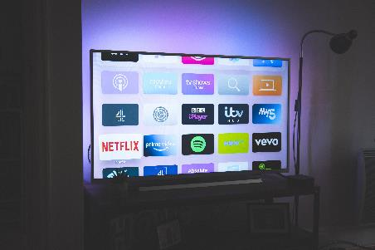
Summary III. - the concept
The new service appeals to two-fifths (42 per cent) of respondents aged 18-59, and merely six per cent rejected it absolutely.
Three in ten (30 per cent) are likely to use the service, and another four in ten (40 per cent) would consider to use it. From among them, every fourth (26 per cent) would definitely, four in ten (43 per cent) probably and three in ten (27 per cent) perhaps register for the service to be eligible to watch its programmes.
The wide range of programmes and free access to the service appeal most to potential viewers, while advertising blocks slicing up the programme is the less attractive feature of the service.
Nearly two-thirds (63 per cent) would test the service by surfing on it for a couple of days. Every third respondent (30 per cent) thinks that the service represents no novelty, and the same programmes may be found on the internet anyway. Only every fifth potential viewer would use the service if it broadcast programmes without Hungarian dubbing.
When ranking service features being the most attractive to respondents aged 18-59, free access comes clearly first, followed by online availability (i.e. it may be watched irrespective of one’s location). They would also like to receive channel recommendations by interest. Advertising blocks interrupting the programme and running between programmes pose a barrier to use, and banners are not liked by potential users either. The lack of live programmes and registration mean no problem for them.
By using this service, they are most likely supposed to watch nature films, (feature) films, series, sports, gastronomy and educational programmes.
Notes:
Image: https://www.pexels.com/hu-hu/foto/par-szeretet-ules-este-4009409/

Slide 37
Summary IV. – the concept / market potential estimate
Though almost each and every potential viewer has a smartphone, this device only comes second as preferred device to watch the programmes on. Smart TV is the number one, instead.
Respondents would use the new service for family entertainment and watching film alone, too.
It if proves to be a fair choice for them, a high share of potential viewers would switch to the new service. The time spent on the new service could even surpass two-fifths of the total time spent with content watching, true though, the time spent with content watching on other platforms would consequently decrease.
Based on a description of the service, only every sixth (16 per cent) potential viewer would ponder seriously over cancelling their classic linear TV subscription. Unsubscribing from a streaming service would be considered by even fewer, only every eigth (12 per cent) of them.
Based on responses, we’ve built a potential estimate on how many viewers being enthusiastic for the new service would get as far as registering for the new service. The analysis considers all rational and emotional barriers on the journey to registration. We estimate that even 45 per cent of the target group may get as far as registering for the service. Those aged 50-59 years and those having smaller classic linear TV subscription package are overrepresented among potential users.

Slide 38

3
Results detailed
38
Notes:
Image: https://unsplash.com/photos/hpjSkU2UYSU

Slide 39
TV viewing habits

Slide 40


TV subscription in the household
Almost every member of the target group have a TV in their household (it is significantly less typical to the youngest age group than to the older ones, and those living in Budapest are significantly less likely to own such a device than people in other parts of the country). Likewise, almost every household has a TV subscription (though a sigificantly higher share of repondents aged 30-39 reported not to have any).
TV in the household*
Subscription type
mindigTV service*
A01. Does your household have a TV set or a monitor also used for watching TV? | Base: total sample, n=600 | *or a monitor also used for watching TV
A02. What kind of a TV subscription does your household have? | Base: those having a TV set or a monitor also used for watching TV, n=564
A03. In case of mindigTV, do you pay a fee or use the free service? | Base: those having a mindigTV subscription, n=25 | *Inadequate number of data points, data given for information only

Slide 41
The number of channels available and viewed
Based on knowledge (or estimate) of respondents, TV subscription packages contain nearly 100 channels on average, from which they used to watch below 20 ones. So, every fifth channel.
It is irrespective of demographic features how many channels in the package viewers used to watch.
Number of channels
Number of channels viewed
Total number of channels vs. number of channels viewed
Average:
98 channels
Average:
19 channels
Average:
22per cent
A04. How many channels do you have in your TV subscription package (excluding HD channels)? | Base: those having a TV subscription, n=501
A05. If you watch TV without a specific purpose, how many channels do you usually switch between in order to find a programme you would want to view? | Base: those having a TV subscription, n=501

Slide 42
Number of TV sets in the household, use of main television
On average, target group members have two TV sets (or a monitor also used for watching) in their households. There are significantly fewer TV sets than the average in homes in Budapest, and more in villages. The number of TV sets certainly depends on the household’s size (the larger the family the more TV sets it owns). Families with kids own significantly more TV sets than the average.
The main television is mostly used for the joint entertainment of the family, but every third respondent most often used to watch TV alone.
Number of TV sets in the household
Use of main television
Average:
1.8
A06. Does your household have a TV set or a monitor also used for watching TV? | Base: total sample, n=600 | *or a monitor also used for watching TV
A07. In which cases do you mostly use your (household’s main) TV ? | Base: those having a TV set or a monitor also used for watching TV, n=564

Slide 43
Preferring better image quality
In half of the households having more than one TV sets, decision for the main television is usually taken for its spectacular image quality.
The vast majority of those with a TV subscription have access to HD broadcasts, and target group members also choose them for their entertainment.
Two-thirds of those aged 18-59 often specifically choose the household’s main television because the image quality is the best thereon.
The reason why the household’s main television is chosen: the most spectacular image quality in the household
(households that have at least two TVs, n=359)
Main television chosen specifically for its spectacular image quality
(households with at least two TVs and access to HD broadcasts or choosing to watch it for its spectacular image quality, n=345)
HD broadcast viewing
(those with a TV subscription, n=501)
A08. Why do you usually choose your (household’s main) television? | Base: households having at least two TVs, n=359
A09. Is your (household’s main) television capable of receiving HD broadcast? | Base: those having a TV subscription, n=501
A10. How often do you watch HD broadcast on your (household’s main) television? | Base: the (household’s main) television is capable of receiving HD broadcast, n=445
A11. How often do you choose to watch your household’s main television specifically for its most spectacular image quality? | Base: those who watch the main television for its spectacular image quality, n=345

Slide 44
Choosing the household’s main television
The most obvious reason for choosing the main television is that it is in the main room of the dwelling. If the technical parameters of the television are taken into account, the picture is somewhat mixed, with screen size taking precedence over image quality.
Neither larger screen size nor spectacular image quality is significantly more important for either demographic group.
A08. Why do you usually choose your (household’s main) television? Assess the following criteria on how important a role they play in your selecting this television for watching TV. |
Base: households with at least two TVs, n=

Slide 45
Streaming services
More than half of the households have access to a streaming service, from among which Netflix is the most popular. Nearly every second household of the 18-59 year old population have access thereto, whereby HBO Max and Disney+ are also popular. Households with members aged 18-29, being active, raising children and having a net monthly household income of over HUF 500,000 are significantly more likely to have a streaming subscription.
Noteworthy, though, that every third of them use the service for free because they received access thereto as a gift or shared by a friend or family member.
(Note that RTL+, the paid streaming service of RTL has been launched after our data collection, which is why it is not considered by this research)
A12. Which streaming service provider’s streaming services does your household currently have access to? | Base: total sample, n=600
A13. Do you have a streaming service that you’ve received access to as a gift along with another service, or that you’ve signed up to for a trial period, hence use it for free? | Base: total sample, n=600
A15. From among the streaming services available in your household which one do you have no direct subscription to because you receive access thereto from a friend or relative?| Base: total sample, n=600

Slide 46

Other online content
Every seventh household has a Premium YouTube subscription. Among them, those aged 18-29 and those whose households earn a monthly income of at least HUF 500,000 are overrepresented.
Every sixh target group member has bought specific online content in the three months preceeding this research. Within, those aged 18-29 have a significantly higher share than the average.
Google TV is the most popular among specific content bought, followed by Telekom’s own SVOD.
Youtube Premium
Access bought to specific content
A16. Does your household have a YouTube Premium subscription? | Base: total sample, n=600
A17. Have you watched any content (film, series, etc.) online in the last three months, in case of which you have only bought access to that specific content? (e.g. Google TV, a video game by the TV operator, etc.)? | Base: total sample, n=600
A18. Which service providers’ service did you use in the past three months, in case of which you only bought access to a specific content? | Base: those having bought access to specific content, n=100

Slide 47
Content viewing habits
Every second in the age group 18-59 used to watch classic linear TV on a daily basis, while every fifth does so several times a week. The older the viewer the more likely they watch TV on a daily basis.
Every third target group member watches YouTube every day (those aged under 40 are significantly overrepresented among them), and another nearly one third does so several times a week. Almost every fifth member of the group aged 18-59 uses streaming services on a daily basis, and another one-fifth views streamed content several times a week (the also largely belong to the age groups under 40).
The target audience consumes online programmes, particularly live streams of TV operators significantly more rarely than other content services.
A19. How frequent do you watch the followings? | Base: total sample

Slide 48
Programme viewing habits by content providers
Obviously, the most diverse content is viewed on classic linear TV. We must underline that it is series and (feature) films that clearly make streaming services be preferred by subscribers, while YouTube is mainly used to get access to music content.
(n=506)
(n=396)
(n=252)
(n=319)
(n=545)
A20. What kind of programmes do you regularly watch on the services you use? | Base: those viewing content by a content provider at least occasionally

Slide 49
Former TV subscription
At the time of data collection, six per cent of the households aged 18-59 with a TV set had no TV subscription. Although the number of data points is inadequate, most of these households had such a service in the past. Every third respondent cancelled their subscription for not having found any programmes to their liking, and another one-third disliked the excessive amount of advertisements.
A21. Did your household previously have a classic linear TV subscription? | Base: those currently having no TV subscription, n=38
A22. For which reasons did you cancel your classic linear TV subscription? | Base: those who formerly had a TV subscription but currently have none, n=25 | *Inadequate number of data points, data given for information only

Slide 50
Former streaming subscription
One-seventh of those aged 18-59 and having no streaming subscription (less than half of the total sample) had such a service in the past. More than half of them did not use it, so cancelled it, while two-fifths found it too expensive, and one-sixth could not find any enjoyable content on these platforms.
A23. Did your household have a steraming subscription (like HBO Max, Netflix, Disney+, etc.) in the past? | Base: those with a current streaming subscription, n=263
A24. For which reasons did you cancel your streaming subscription (e.g. HBO Max, Netflix, Disney+, etc.)? | Base: those who formerly had a TV subscription but currently have none, n=33

Slide 51
Reasons for subscribing to streaming services
The main reason for subscribing to a streaming service is its being free from ads followed by a wide range of programmes that can be watched any time (on demand). These reasons have been mentioned by 4-5 in ten respondents. Three in ten reported that they like the sense of choice; the fact that they can access specific content that is only available here, which is why the latest releases can be viewed and the service is available anywhere without limitation.
Foreign content and thematic programmes are only important for every tenth subscriber (at least at the time of subscribing).
A25. For which reasons did your household subscribe to a streaming service (like HBO Max, Netflix, Disney+, etc.)t? | Base: those with a streaming subscription, n=337

Slide 52
Handling of services
For the target group, classic linear television is the simplest to handle, but it is certainly because that’s what they are used to for decades.
Those aged 18-59 find Youtube fairly easy-to-handle from among online content, and Disney+ and Netflix from among streaming channels.
(n=501)
(n=545)
(n=119)
(n=267)
(n=176)
(n=44)
(n=18*)
(n=54)
(n=41)
(n=11*)
A19. How simple do you think the following services are to handle? | Base: those with access to a specific content | *Inadequate number of data points, data given for information only

Slide 53
Prices of online services and perception of the price level - by subscribers
Half of the households pay less than HUF 5,000 for online services a month, while nearly every tenth household pays over HUF 10,000.
From among streaming services, Amazon Prime and HBO Max count as the cheapest, while Apple+ is considered the most expensive. (In case of the latter one, data are given for information only due to inadequate number of data points) The prices of these services are regarded as realistic, 15-25 per cent find these prices expensive.
Monthly costs of online services
(n=374)
Perception of the price level of streaming services
(n=44)
(n=176)
(n=119)
(n=267)
(n=18*)
A27. How much do you pay a month in TOTAL for the access to ONLINE content services? | Base: those with subscription to a streaming service or Youtube Premium or who used to buy specific content
A28. How expensive do you think the following services are? | Base: subscribers to a streaming service | *Inadequate number of data points, data given for information only

Slide 54
Prices of streaming services and perception of the price level - by non-subscribers
Non-subscribers to streaming services have estimated the average monthly cost at around HUF 2,000-5,000. A slightly larger share of non-subscribers deem the assumed service price expensive than that of subscribers.
The assumed cost of
streaming services
(n=217)
Perception of the price level of streaming services
(n=130)
A29. To your knowledge, approximately how much does a subscription to a streaming service (online content viewing) cost a month? | Base: those having no subscription to a streaming service, n=217
A30. How expensive do you think a subscription to a streaming service (online content viewing) is IN GENERAL? | Base: those having no subscription to a streaming service but estimating the price of it, n=130

Slide 55
Monthly payment for the services
Clients decisively count costs pertaining to content provision to overheads. Streaming, however, is an exemption in the rule, as it is considered by the majority of its users as an extra media service.
(n=541)
(n=501)
(n=584)
(n=337)
A31. Do you count the following costs to basic overheads or do you consider them as an extra media service cost? | Base: total sample

Slide 56
Downloading online content
Four in ten target group members (or a member of their households) used to download films or other content from the internet. They are mainly younger (under 40) men.
The lawfulness of such downloads, however, is doubtful. If someone downloads content for own use, it is considered lawful. Torrenting, however, implies also sharing of the file (i.e. content), even if it’s done with a non-profit purpose*. Since our relevant survey question clearly hinted at torrenting, we examine its lawfullness in this sense. So, a good fourth of downloaders is convinced that it is a lawful act, while nearly two-thirds think it’s unlawful.
Downloading content from the internet
Downloading from the internet – lawful?
D01. Do you or anyone in your household download films/programmes from the internet or anywhere else (e.g. by torrenting - ncore, bithuman, etc.) | Base: total sample, n=600
D02. How much do you think torrenting films/programmes is legal? | Base: those used to download content from the internet, n=238
Source: https://legisly.com/legalis-e-a-torrentezes-miert-lehet-2021-ben-felnivaloja-annak-aki-torrentezik-jogaszkent-oszinten-a-fajlcserelesrol (downloaded on 23 November 2022)

Slide 57
Advertising blocks, TV viewing attitudes

Slide 58
Switching away from the advertising blocks
Six in ten respondents aged 18-59 usually or almost always switch over to another channel as soon as an advertising block interrupts the programme. They would refrain from switching away only if they left the room and didn’t care what is on TV. The fact that the remote control is far away from them does prevent them from switching away to a lesser extent, they rather stand up and reach out for it in order not to have to endure the entire advertising block. Some switch away also in cases when a programme is on that caters for their interest, taking the risk of missing what comes next (or a part of it). They tolerate a maximum of 3-4 adverts before they consider to switch away.
An advertising block of how many ads would you be wiling to endure (those who usually or never watch advertisements)?
On what conditions would you not switch away from the advertising block?
B01. Do you usually endure and watch advertisements preceding or interrupting a show? | Base: total sample, n=600
B02. In which of the following situations would you possibly be willing not to switch channels as soon as an advertising block appears? | Base: those who usually don’t or never watch advertisements, n=404
B03. If you knew in advance the number of adverts that will be aired in an advertising block, how many of them would you be willing to tolerate? | Base: those who usually or never watch advertisements

Slide 59
TV-viewing attitudes
Four in ten viewers aged 18-59 often watch films or series they have already seen, and hardly any of them watch content previously seen.
TV viewing planned on basis of a teaser or a programme guide is only characteristic of every fifth respondent, whereby every third of them reported to sometimes watch TV on the same basis.
Two-fifths of those with a TV subscription do not think that they are offered too many channels in their packages. Not even one-third of those having access to over 150 channels perceive the range of channels being at their disposal as excessive.
Rewatch of films, series formerly seen
Watching content based on teaser
Too many channels
in the TV package
B04. How often do you watch films, series that you have previously seen? | Base: total sample, n=600
B05. How typically do you switch to a specific programme based on a teaser or the programme guide? | Base: total sample, n=600
B06. How much do you feel having too many channels offered in your TV service package? | Base: those with a TV subscription, n=501

Slide 60
Finding the right programme
Three-fourths of those aged 18-59 find it important that a programme is entertaining and less important how fresh it is. It is worth comparing it with how often respondents used to rewatch films, series formerly seen. It cannot be statistically evidenced that those who rewatch (very) often films or series formerly seen consider the entertaining nature thereof as important.
Two-fifths of the target group usually fail to find programmes to their liking even in spite of the extensive offering. This factor is in connection with the number of channels they have access to in their package, i.e. those with fewer channels are more likely to find no programme to their liking.
Popularity of former programmes
Finding enjoyable programme
B07. Which of the below statements is the most true of you | Base: total sample, n=600
B08. How often do you find a programme to your liking on classic linear TV channels when you’re watching TV? Which is the most true of you? | Base: those with a TV subscription, n=501

Slide 61
The concept

Slide 62
The service presented
This new solution is a digitally available TV service. Through an app or a web browser, you can access a platform similar to an electronic programme guide, where you can find a myriad of virtual channels, which are typically not available on cable TV. You can join in watching any of these at any time. These are the only channels you can choose from, and the programmes on these channels are fixed, just like on traditional TV channels.
Access to the programmes is free, but there are advertisements placed in the programme stream in the same way as on traditional television. You cannot skip the ads.
Such a “package” may even contain hundreds of channels. The channels are usually organised around specific themes. These may be channels catering for very specific interests such as crime thrillers, episodes of previously broadcast series (e.g. CSI, Baywatch), yoga programmes, hidden camera scenes, quizzes, cooking shows, animal care, religious programmes, biographies or classic cartoons.
The content is typically not freshly produced, but a structured flow of thematic contents that were previously broadcast somewhere else.
The service is available via the Internet.

Slide 63
Concept: appeal, potential order, registration
Four in ten respondents aged 18-59 like the concept of the new service (very much), and only one-sixth expressed dislike. The perception of the concept does not significantly vary across demographic groups.
Nearly every third target group member would (probably) use the new service and would even register for it if necessary. In this case, there are no demographic differences between potential users.
Appeal
Use - registration
C02. How much do you like this service ? | Base: total sample, n=600
C03. How likely would you use this service based on the above description? | Base: total sample, n=600
C08. If the service could only be used on condition of (free) registration, how likely would you be to register? | Base: those who would (probably) use the service, n=423

Slide 64


Positives and negatives of the concept
The two key buzzwords of the new service may be “free” and a ‚wide programme offering”. Among positives of the service, target group members also frequently mentioned its thematic feature and the fact that it is available anywhere, anytime and on any device.
Non-skippable advertisements interrupting programmes pose a problem, with every third respondent aged 18-59 having made mention of it.
Like
Dislike
C04. What did you like in the service presented? | Base: total sample, n=600
C05. What did you dislike in the service presented? | Base: total sample, n=600

Slide 65
Assessment of concept features
As in the case of spontaneous mentions, free access is the most appealing feature of the concept. Three-fourths of the 18-59 year old respondents appreciate that the new service would offer a mixed content on even hundreds of channels in the digital space.
They would be reconciled to registration. Based on the relevant survey results, they perceive this as more of a “must” than of a remarkable positive feature.
Three in ten target group members can more or less tolerate interruptions of the programme flow by advertising, while nearly every second respondent absolutely dislikes it.
C16. How much do you like the followings in the service presented to you? | Base: those who would (perhaps) use the service, n=423

Slide 66
Opinions on the concept
Respondents aged 18-59 are open-minded towards the new service, six in seven are likely to give it a chance and surf on it for a couple of days. Every fourth potential viewer believes that this service is expressly for them, but three in ten think that the expected content is anyway available on the internet, hence it is not really a novelty. Every fifth respondent associates “free” feature with low niveau, true, though, that four of ten target group members disagree with this statement. Hungarian dubbing is utmost important for those potentially registering for the service - only every fifth would give this up. Concerns over advertisements have been detailed above: seven in ten potential viewers would find it annoying if advertisements interrupted the flow of programmes.
C17. Concerning the service just presented to you, how much do you agree with the following statements? | Base: total sample, n=600 | *Those who only have a smartphone and no other smart devices, n=31

Slide 67
Attractive features of the concept
Free access to the service is perceived as the key feature of the concept, three target group members have ranked it first. The next three features are attractive to a similar extent: online availability, thematically structured channels and wide channel offering. From among the six features under view, old content and registration are seen as the most rejected. (It must be noted that these only rank last in terms of the six features surveyed here. Earlier we saw that potential viewers do not reject old content (as far as it entertains!) and they can live with registration, too.
C20. Please order the followings by importance along how attractive they are for you upon using the service. | Base:those who would (perhaps) use the service,
n=423 | 1=Very attractive, Not at all attractive | (Very) attractive=in the first and second place, moderately attractive=in the third and fourth place, not (at all) attractive=in the fifth and sixth place

Slide 68
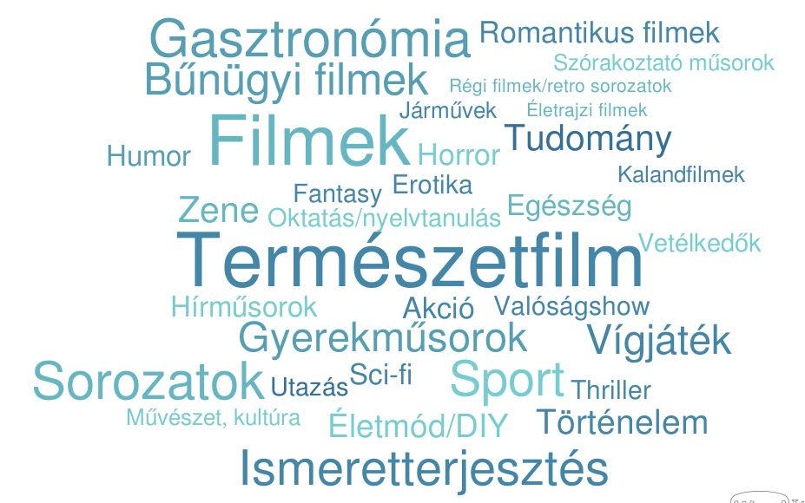
Proposed channel themes
18-59 year old respondents who can imagine to register for the service would mainly like to watch nature films and movies under the new service. Series, gastronomy, sports and educational content (documentaries) were also often mentioned.
C08b. Which thematic channel would be of interest to you? Let your imagination soar and describe the programmes of which thematic channels would you be happy to view. | Base: those who would (perhaps) use the service, n=423

Slide 69
The (most probable) device to use the service on
Viewers are most likely to use the service on their smart TVs, but there are a number of people who would prefer to use it on their smartphones.
In terms of demographic characteristics, no group can be singled out that would specifically prefer to use a (smart) device.
C06. Which device would your household use the service on? | Base: those who would (perhaps) use the service, n=423
C07. Which device would your household mostly use the service on? | Base: those who would (perhaps) use the service, n=423

Slide 70
Circumstances of use
Earlier we saw that target group members use their household’s main television primarily for watching films with family, followed by watching TV alone. In connection with the new service, there is hardly any difference in the perception of these two forms of entertainment, i.e. both are envisaged by every second respondent.
Since the service can be accessed online, every sixth potential viewer would be glad to watch it when travelling or going on holiday and it is possible because most accommodations offer WiFi, too.
C09. In what situations can you imagine using the service? | Base: those who would (probably) use the service, n=423

Slide 71
Share of the new service in the total time spent with watching content (among those being interested in using the service)
Basically, regardless of whether a potential viewer has a streaming subscription in addition to a TV subscription (or whether they watch online content other than this), they would spend a third of their time spent with content watching on the new service, i.e. the range of numerous, different thematic channels raised interest (we presume, though, that this estimated share will (largely) exceed the expected share).
It is women, lower educated, inactive, divorced or widowed population, parents with kids and those with lower monthly net household income who would view the service’s programmes in a significantly higher share than the average.
(n=600)
(n=550)
(n=287)
(n=214)
(n=35)
C18. Based on your current content viewing habits and considering the service presented, in what percentage would you use the new service? | Base: total sample

Slide 72
Content viewing habits
In order to keep up with the new service, target group members would watch the new channels at the expense of other content services. They would most probably give up on classic linear TV service. The new service, however, could drain away viewers from paid streaming services, too.
Nearly every tenth member of the potential target group envisages not to change their customary content viewing habits, but to add the new service to their portfolio, that is that they would spend overall more time watching content.
C19. If you were to spend a part of your total TV viewing time on the new service, which types of programmes do you think you would watch for less time? | Base: those who would (perhaps) use the service, n=423

Slide 73
Cancelling classic linear TV / streaming subscription
Every ninth potential viewer envisages to cancel their classic linear TV subscription, with further three in ten considering cancellation too.
Five per cent of the total target group envisages to cancel their streaming subscription, with further every sixth target group member considering the same.
In principle, in none of the cases of cancellation can a certain demographic group be identified that is significantly more likely than average to consider terminating their existing contracts.
Cancelling classic linear TV subscription
Cancelling
streaming subscription
C10. Upon emergence of such a service, would you consider to cancel your classic linear TV service (cable TV, satellite TV, mindigTV)? | Base: total sample, n=600
C11. Upon emergence of such a service, would you consider to cancel your streaming service (e.g. HBO Max, Netflix, Disney+, etc.)? | Base: total sample, n=600

Slide 74
Weekend house/holiday cottage
One-eighth of those aged 18-59 have a weekend house/holiday cottage, and a good third of these are also equipped with access to the internet. Due to the inadequate number of data points, this is just a slight indication that those with a linear TV subscription would probably not cancel it but use it in addition to a possible new service. Those having no TV subscription, however, would consider to register.
Probably cancel: 2 respondents
Possibly cancel (or not): 3 respondents
Probably not cancel: 3 respondents
Definitely not cancel: 1 respondent
Definitely register: 1 respondent
Probably register: 5 respondents
Possibly register (or not): 7 respondents
Probably not register: 1 respondent
Definitely not register: 2 respondents
C12. Does your household have a weekend house or holiday cottage where you have access to the internet or you can use your mobile internet subscription for unlimited data? | Base: total sample, n=600
C13. Do you have a subscription to classic linear TV (cable TV, satellite TV or mindigTV) in your weekend house/holiday cottage? | Base: total sample, n=600
C14. Upon emergence of the new service presented, would you consider to cancel your classic TV service (cable TV, satellite TV, mindigTV) in your weekend house/holiday cottage? | Base: those having a weekend house/holiday cottage with internet access and linear TV subscription, n=9
C15. Would you register for the new service in order to be eligible to watch its programmes in your weekend house/holiday cottage? | Base: those having a weekend house/holiday cottage with internet access, but no linear TV subscription, n=16
*Inadequate number of data points, data given for information only

Slide 75
Barriers to use
As formerly seen, it is primarily advertisements interrupting the flow of programmes that would pose a barrier to use of the new service. At the same time, banners appearing during the programmes may also be annoying. Advertisements placed in between the programmes (instead of interrupting the flow of those) are envisaged to be more tolerable. Mandatory registration or the lack of live broadcasts would not mean a problem for potential viewers, they could live with it.
C21. Please order the following factors by importance along how much they would pose a barrier for you to use the service. | Base: those who would (perhaps) use the new service,
n=423 | 1=Very much, Not at all | (Very) much of a barrier=in the sixth and seventh place, moderately of a barrier=in the fourth and fifth place, (almost) not (at all) a barrier=in the first and second place

Slide 76
Market potential estimate

Slide 77
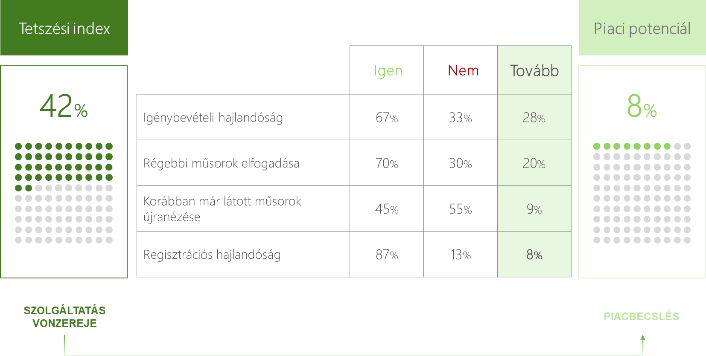
From appeal to a real market share
EXAMPLE
1. Share of viewers who said they liked the service
2. Numerous barriers may hinder potential viewers in registering
Our potential estimate is based on the logic that just because a consumer likes a new service concept, there are still a number of barriers that may prevent them from registering for the service.
Therefore, by adjusting the share of those feeling attracted by the concept with the number of those who “failed to overcome” such barriers we may get an estimate that covers all consumers representing real market potential.
3. Share of potential viewers who would probably fail to register due to a barrier
4. Final share of consumers with real intent to subscribe after having overcome all barriers

Slide 78
Potential estimate: from appeal to a realistic market potential
Based on responses, we’ve built a market potential estimate for the envisaged new service. Starting out from the number of viewers who like the new service we have estimated how many of them would get as far as registering for the new service. Each step of the barriers and the “overcomers” are defined below, whereby the exact data are shown on the next graph.
Appeal index
How much do you like this service? (moderately / more than not / very much)
Based on the description, how likely would you use the service? (possibly / probably / very probably)
Which statement is more true of you? (for me, it is not the freshness of a programme that matters, but that it entertains)
How often do you rewatch films or series that you saw in the past? (very often / often / sometimes)
If the service could only be used on condition of (free) registration, how likely would you be to register? (perhaps / not likely / definitely)
Willingness to use
Fresh vs old content
Content formerly seen
Registration

Slide 79
Potential estimate: from appeal to a market potential
From among 83 per cent of respondents liking the new service only 45 per cent will become genuinely potential registrants if we take into account the barriers arising during the journey.
Appeal index
Market potential
 | Yes | No | Next
Willingness to use | 84 per cent | 16 per cent | 69 per cent
Acceptance of non-fresh programmes | 70 per cent | 30 per cent | 48 per cent
Rewatch of content formerly seen | 96 per cent | 4 per cent | 46 per cent
Willingness to register | 97 per cent | 3 per cent | 45 per cent
83 per cent
45 per cent
ATTRACTION OF THE SERVICE
market appraisal
Respondents aged 50-59, and those with less than fifty channels are overrepresented in the potential target group. There are no further demographic features or content viewing habits that would affect the willingness to register.

Slide 80
FAsT TV on the viewers’ market - summary I.
Comparing the FAsT TV concept with other video content, the following conclusions can be made.
In terms of content it largely resembles to linear televisions (channels, edited real-time programme, advertisements in the advertising flow).
No TV subscription is needed for the access to the service. Anyone having access to the internet can use it for free. (Currently, there are a few TV channels that are available free of charge, e.g. free channels of mindigTV or free channels shared by content owners such as Mediaklikk.hu).)
Based on examples from the United States, there is an extremely vast number - even hundreds - of channels to choose from in such a package.
In contrast to other digital platforms, selection of content is less flexible in as much no specific programme, but only the channel can be selected.
Considering it as a competitor to linear TVs, the lack of fresh content differentiates it from premium channels because, like other channels, the platform exclusively offers non-fresh content.
The concept must compete for the audience's attention with the above features.
On the next slide, we summarize the advantages and drawbacks of the concept from the viewers’ perspective.
80
Notes:
Image: https://unsplash.com/photos/EOQhsfFBhRk

Slide 81
FAsT TV on the viewers’ market - summary I.
Viewers have 100 channels on average, but they watch roughly one-fifth thereof. FAsT TV can, in principle, provide them with the same diversity.
A good half of households currently uses streaming services, hence at least so many are capable of using the FAsT TV service.
Vehement ad-avoidance by linear TV viewers emerges as a major challenge for the service. Seventy per cent of the target group said that they almost always switch away immediately from a channel upon the start of a block of advertisements. In their case, shorter advertising blocks may provide a fair solution. Roughly half of them could be kept in front of the screen if advertising blocks contained only a maximum of 1-2 spots, and another 40 per cent would probably tolerate a maximum of 3-4 spots. In view of the number of adverts tolerated in online video services, there is by far more room for ad placement on this platform.
The appearance of non-fresh content emerges as no big problem in itself either. Fourty per cent of the target group often rewatch content they have formerly seen, and another 50 per cent do so occasionally. These two groups together provide a market potential of above 90 per cent.
Based on a short briefing, the new service appeals to around 40 per cent of the target group and another 40 per cent of potential viewers like some elements of it.
Thirty per cent said that they would highly probably use such a service, and 40 per cent see a slight chance thereof. The fact that the use of the service is tied to registration would deter only very few potential users.
The service would be preferably used on smart TV which again strongly confirms that it is considered as more of television.
Having such a service would presumably not increase the total time spent watching motion pictures. Only every tenth respondent envisages to consume more content. Consequently, the new service is supposed to rearrange current content consumption. Most think that their linear TV consumption would drop followed by a decrease in other (mainly user-generated) content viewed. It is paid streaming services that the new service is least supposed to take away time from. Respondents have anyway overestimated the rate of use of the new platform. Based on primary opinions, even one-third of the total viewing time may be diverted thereto. It, however, necessitates the broadcast of valuable content that could not be tested in this research.
In spite of the presumed large consumption volume, only an extremely small share in the target group is envisaged to cancel their TV or streaming subscriptions, i.e. none of the paid services could fully replace FAsT TV.
Based on responses, even half of the target group would register to such a service entering the Hungarian market. Certainly, its reception will largely depend
on the available content and the volume of advertisements aired on it.
81

Slide 82
03
Expert (agency) interviews
On advertising market opportunities for the FAsT TV concept
82

Slide 83
Background, methodology
The FAsT TV concept is not only competing for viewers on markets which the business model is implemented on, but, as it is financed exclusively from advertising revenues, it must also stand the chance in the advertising market.
In this research, we also sought the views of advertising professionals on the concept. A total of 10 agency heads gave their views in eight interviews.
On the basis of a short description of the concept, the most important questions asked in the online qualitative interviews explored where they would position this new solution in the advertising market, what role they can envisage for it and how they see its chances in an already turbulent market.
It was not an easy task for the interviewees because, as some of them highlighted, it is complicated to assess this new platform due to the lack of information on the content, usage and viewership, and the advertising sales model it would apply. Experts' opinions should be viewed in accordance with the fact that knowledge of the exact parameters of the potential new service would allow a more precise assessment.
TIMING OF THE INTERVIEWS:
November 2-21 2022

Slide 84
Summary

Slide 85
Summary
In respect of advertising, interviewees still consider linear TV as an inevitable market player. Not even the years-long decline in viewership, particularly in certain higher-status target groups, has affected its position significantly. It remains the best media type for reach building, it works well in most target groups and when using it in combination with complementary media, great results can be achieved even in critical target groups. TV is a mass medium and is not really used for targeting. So, neither the channel mix applied nor the time of day play a key role in planning. Even the impact of the broadcast environment is insignificant. Advertisers who strongly prefer a certain kind of broadcast environment will tend to turn to non-spot solutions.
The findings of the situation assessment, in general and respectively, quite clearly are in support of the appearance of a service based on the FAsT-TV concept, at least from an advertising perspective.
The experts interviewed have not heard of the FAsT TV business model yet, but find the concept interesting. While discussing the concept, the first question that immediately arose was “who could launch such a service in Hungary”. They do not see it as a preferred business strategy to follow by either large international or Hungarian content providers.
In case such a service were implemented, a further dilemma concerning the target group arises. The technical means of viewing is supposed to attract younger, higher-status viewers, while the content is thought to attract older, lower-status viewers. This contradiction may slow down any increase in viewership.
As for the viewing habits associated with the new platform, a non-prime-time, but rather daytime, long ATS (viewing time), not overly focused viewing situation is envisaged.
From viewers' perspective, the new service could compete more with linear TV, but from an advertising (mainly media planning and media buying) point of view, it can be considered more as a digital medium. Interviewees envisage sales either through a sales-house or through programmatic inventory. As it would be sold in a similar way as are online videos, it could first draw advertising revenue therefrom. On the long run, by building the online video market, it could also gain sales from TVs. They would price the concept above YouTube videos, slightly below the online platforms of Hungarian service providers (RTL, TV2) and considerably below the expected prices of international SVOD providers (Netflix, Disney+) that might enter the market.
The main advantages of FAsT TV are thought to be the little advertising noise, good plannability, availability for quick and easy campaign launch and its suitability to view it on a large screen.

Slide 86
Market situation

Slide 87
Linear TV-viewership I. - tendencies
As from the viewers' point of view, the new service may be most similar to linear TV and it is important to see in which direction this market is currently heading.
Agency experts see no drastic changes in linear TVs’ viewership. Even though the share of the "other" category in Nielsen's audience measurement is growing, the decline in linear TV viewership can in no way be considered as dramatic. A decrease can be seen in some target groups, but the pace thereof is not reckoned remarkable and this decrease is more of an erosion than a plummet.
The main reasons for this decrease basically include the increasing availability and popularity of streaming services, the consumption of motion pictures via non-TV screens (mainly user-generated content), but also, for example, rewatch of attractive content on linear TV, which in turn contributes to the decrease in the time spent on watching classic linear TV.
Some positive developments were also mentioned:
TV viewing generated by confinement brought about by the COVID epidemic
the amount invested by major content providers in their own programmes, which has resulted in improved programme quality
a less positive development - rather from the aspect of linear TV - is that high inflation and the worsening economic situation are increasingly keeping people at home, thus leaving them potentially more time for TV.
"Let's say you're an X-factor fan, then you will in any way sit down in front of the X-factor show. Likewise in front of sports programmes if you want to watch them live..."
"They are constantly releasing a brutal amount of own productions and larger-scale shows, so I think this is the way to bring back to TV a higher purchasing power, the more educated viewers."
"There is always innovation in the shows that are promoted really well"
“It clearly outlines from Nielsen data that we're talking about an erosion in viewership, and I do not think this trend would stop."
"Not dramatically, but steadily declreasing, and this decrease is shifting over to streaming and then to OTT platforms."
"There is a drop of a few percentage points in overall views and the time spent on watching TV, but there is no drastic change to perceive"
"In general, ... one in four minutes spent in front of the TV is spent on watching non-linear TV"
"The content they want to watch in a linear way is more likely to be watched online, on rewatching sites, or on the other side, it is the streaming services that take viewership away."

Slide 88
Linear TV viewership II - target groups
When looking at the reception of a new linear TV concept, it is also worth looking at the differences in current TV viewing habits of each and every target group.
The majority opinion is that hardly any change has occured in certain heavy user target groups, but some groups can be identified where a decrease clearly presents itself.
Certainly, this process also affects the position of linear TV in the advertising market.
Numerical evidence shows that in certain segments (mainly young, AB status, metropolitan) the ceiling for TV reach descends lower and lower. Still, in most target groups TV is still a very well usable mass medium that boasts a one-and-only reach-building capacity.
The fact that linear TV no longer delivers the expected reach in the afore-mentioned target groups does not mean that it should be excluded from media plans. In combination with complementary tools (mainly online video), it holds its position relatively strongly in the media mix.
"Watching TV is in worse shape than it was ten years ago, but no one has invented a better way to communicate on it."
"If I have a big 100 per cent target group..., compared to the version thereof 10-15 years ago, I can have a maximum reach of 92 per cent. We simply cannot achieve 97 per cents as in the old days, that's what we see. On another account, there is a considerable, very considerable share of these target groups amounting to 20-25 per cent, who we reach terribly badly on TV."
"Okay, it's harder to reach younger viewers, etc., but if you add further solutions such as stream or digital to TV, you can deliver pretty good reach in practically all target groups."
"For those who target AB status, this is maximum a supplementary medium."

Slide 89
Linear TV viewership III - quality of attention
Although there are no widely accepted data on the contact quality of TV advertising, advertising professionals unanimously believe in its effectiveness and contribution to brand-building. The vast majority of TV adverts are consumed on large screen, which allows for high-quality appearance. As opposed to that, online video ads, which are the biggest competitor, are often viewed on smartphone screen amidst dubious circumstances.
However, in case of linear TV, the level of attention depends on multiple factors, like time of day, content and so on.
In terms of attention, paid streaming services were rated to attract the highest attention. They are currently considered to represent the highest-quality platform for entertainment, which is also reflected in the level of program attention. However, it does not function as an advertising tool, yet.
But not all streaming or online video services are expected to attract high viewer attention. For example, YouTube is associated with slightly lower attention, especially if the viewer is consuming not actively sought content but content that has been suggested by an algorithm and more for passing the time.
Another advantage of linear TV is that viewers are used to a lot of advertising, so they tend to be more tolerant, while online they are eager to move on or even stop watching the respective video content if an advertisement appears.
“Since it's mass media, since it's an audiovisual experience, ... its effectiveness is generally unquestionable.
It does matter how big ... the branding or a product is shown, ... It does matter if it's displayed on a phone screen, ... or really for thirty seconds, with sound, with visuals ..."
"It's all about the cocktail party phenomenon. And it works. If it is said, eer, I don't know let's say varicose vein, and it concerns the person there, it'll grab his/her attention."
"...it depends on the time, the time of day you watch that TV, and what kind of programme you watch at that particular time"
"I think streaming is something that you choose on your own, that's why you might pay more attention viewing it."
"In digital, people have a much lower stimulus threshold. So, even two spots can be irritating. So ... if they're going to watch it on a large-screen TV, and they really watch it like a TV, they may tolerate ads better."

Slide 90
Linear TV viewership IV. - premium vs non-premium content
"I think there's certainly a difference in attention, but there's no measurement that would help you confirm that."
"We can't underpin this by research, but we think that a prime-time slot is worth more than a morning or early afternoon slot, because whatever is on at that time, people are more likely to watch it and get engaged with it.”
"I think it doesn't necessarily matter whether you see a spot in the environment of X-Factor or, I don't know, on NatGeo."
"We just buy an amount of ratings from the sales house and they distribute it across the channels. I have no control over the channel mix they use and where they place the ad within that mix."
"I select the channels with the best programming environment, i.e. I advertise in prime time on the TOP 10 channels. And looking at what percentage of a given target group I’ve reached, I see that I've got a much better campaign in contrast to where they spread the same amount of GRPs across 78 channels."
The channels available in the FAsT TV concept are exclusively based on old (not freshly produced) content. As regards communication effectiveness, it may be of importance to which extent advertisers distinguish between advertising space purchased in a fresh premium content environment and advertising space in other broadcast environment.
Interviews suggest that this is not really an issue in current media planning and buying practices. While interviewees (though not all of them) tend to agree that there can be a difference in favour of "quality advertising time", i.e. mainly prime-time and more popular in-house content, they cannot quantify this difference. On the other hand, current TV advertising sales practices do not support the running of campaigns at real cost that focus on such advertising slots.
On this basis, the features of FAsT TV concept do not, in principle, present a disadvantage in the advertising market.

Slide 91
The concept

Slide 92
Free ad-supported TV concept
None of the agency heads interviewed have ever heard of the FAsT TV business model. We presented the following description of the concept during the interviews, so they expressed their views thereon after a short briefing.
This new solution is a digitally available TV service. Through an app or a web browser, you can access a platform similar to an electronic programme guide, where you can find a myriad of virtual channels, which are typically not available on cable TV. You can join in watching any of these at any time. These are the only channels you can choose from, and the programmes on these channels are fixed, just like on traditional TV channels.
Access to the programmes is free, but there are advertisements placed in the programme stream in the same way as on traditional television. You cannot skip the ads.
Such a “package” may even contain hundreds of channels. The channels are usually organised around specific themes. These may be channels catering for very specific interests such as crime thrillers, episodes of previously broadcast series (e.g. CSI, Baywatch), yoga programmes, hidden camera scenes, quizzes, cooking shows, animal care, religious programmes, biographies or classic cartoons.
The content is typically not freshly produced, but a structured flow of thematic contents that were previously broadcast somewhere else.
The service is available via the Internet.

Slide 93
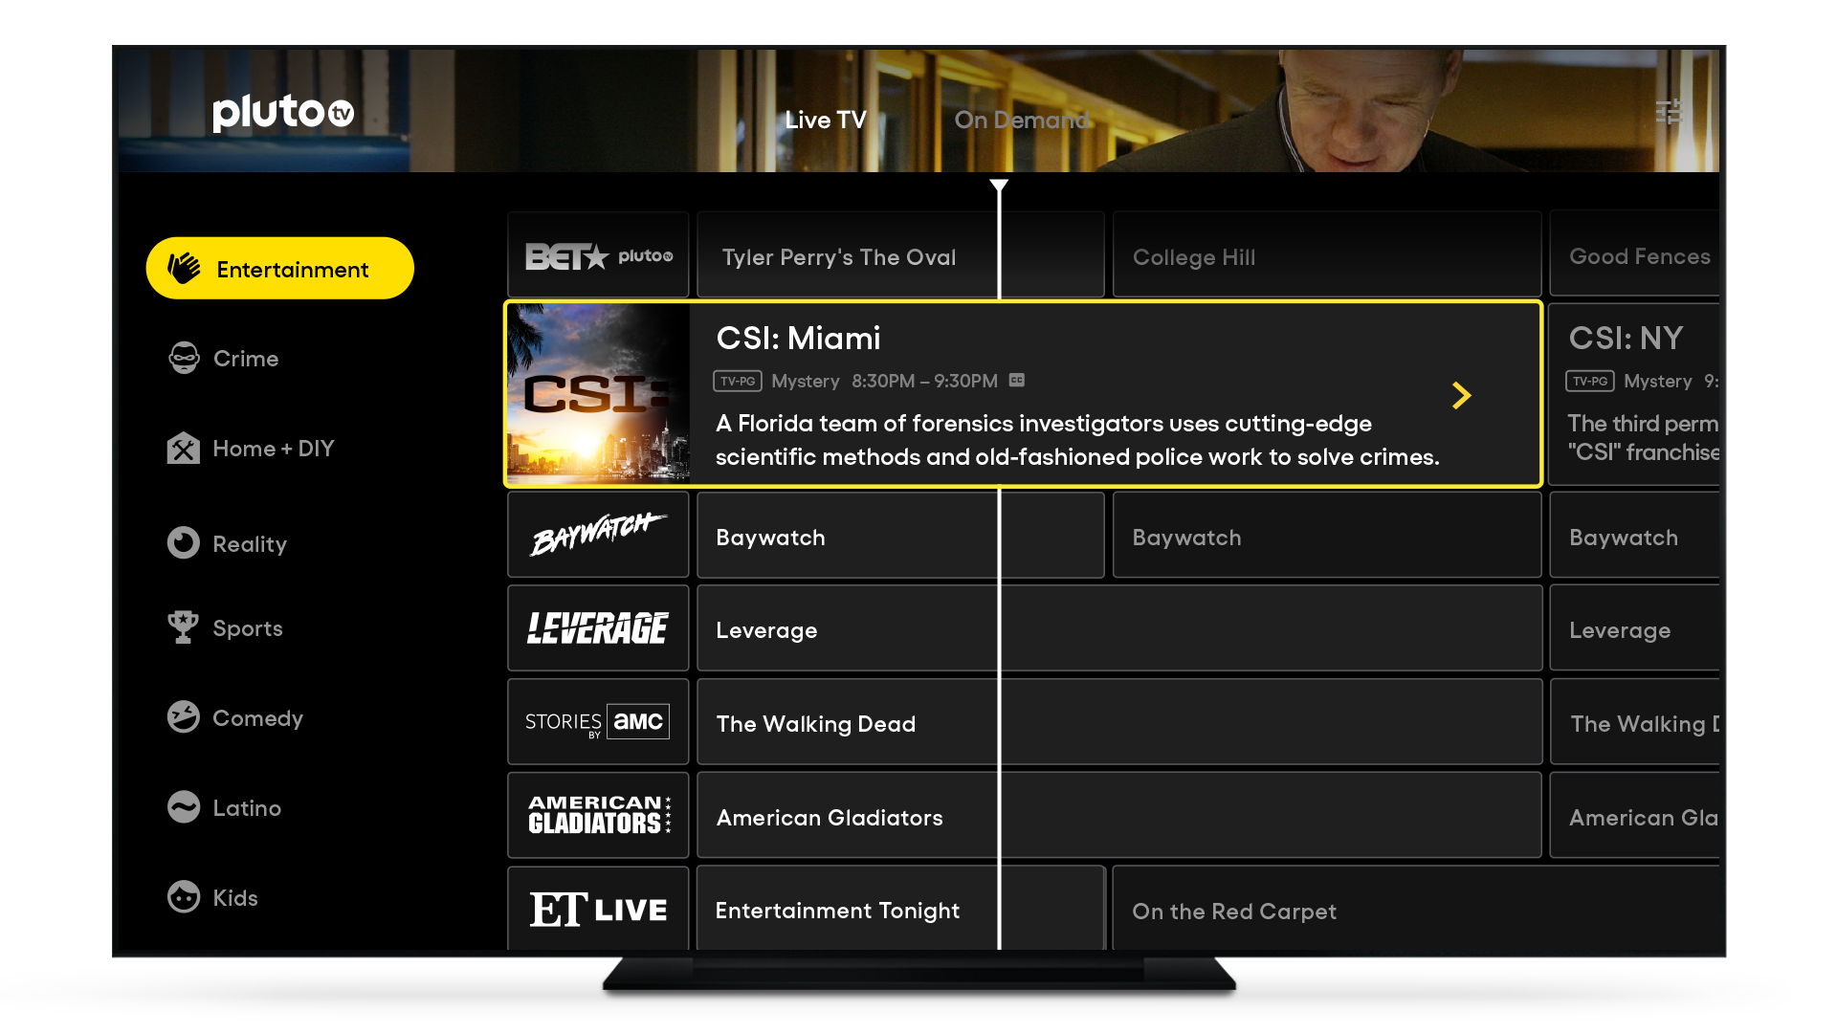
Free ad-supported TV concept
A visual example, a screenshot of "pluto tv" app, was used to further visual understanding.

Slide 94
First impression
In principle, the concept made a positive first impression on interviewees.
Among positive features highlighted first its being free of charge was the most prominent representing a great call to action.
Furthermore, in relation to the business model, interviewees made mention of content producers having a great deal of content that they cannot fully deliver to potential viewers on current linear TV platforms. They perceive this concept as an excellent opportunity.
At the same time, there have been critical voices making it clear that do not find it justified to tie consumers to a "programme guide" in times of the currently so popular streaming platforms, where consumers can choose what they exactly want to watch. With this solution, access to content is more limited and potential viewership may be lost.
"As a content consumer, I'd say it's great. On the other hand, from an advertising point of view, I think it's great anyway. I think that’s fine.”
"I think I understand it completely, and I think its existance can be justified, and I understand why it works in America."
"I think it's an interesting and fun approach. There are certainly target groups for whom this could be of interest. ... so you can certainly make consumers get accustomed to it."
"I'm wondering how it's any different, how it's any better, so it's just that it's free, right? In theory,, free is definitely a great call to action. for us"
"It's a smart idea, because media conglomerates have untold amounts of content, and there's nowhere to broadcast them.”
"I'd be utterly surprised if they could get enough viewers in Hungary to keep it going. And simply because it combines two different parts of two basic types. One of them is linear television, where the programme runs continuously and according to a set schedule. The other is more of a sense of choice in content consumption. Let's consider it a streaming platform, I decide what I want and how I want it. It combines exactly the things that in my view make it a very difficult combo to digest and understand."

Slide 95
FAsT TV on he viewers’ market

Slide 96
Who can launch such a service in Hungary?
After the first impression, many interviewees asked who could launch such a service in Hungary. A major share of the content of foreign content producers is available on a channel in Hungary. These may cause questions of broadcasting law to arise. On the other hand, many of these content producers have launched their own channels in Hungary, where they broadcast this content themselves. It is a question, though, to what extent cable TV-providers would include channels in their packages, the programmes of which are also largely available via some kind of FAsT TV solution. Why should a consumer pay for something they can get for free?
Foreign content is expected to be dubbed, because only dubbed programmes can reach a vast audience in Hungary. The return on dubbing old content may be doubtful.
On top of that, RTL and TV2, which have the most Hungarian content, could also be considered as potential providers. Experts say, however, they have taken a different direction and use a different business model under which they either distribute their available "canned" content on smaller channels (e.g. RTL Gold) or make it available on their own streaming platforms. In relation to Hungarian content producers the rise of a possible conflict with cable operators was also addressed in as much these content producers launch the same free-to-air programmes on the internet as do the cable operators on the channels available in cable packages.
Public media may be another option, but many public channels also show content that is not freshly produced. Thus the question arises, how many channels the public media could feed with content that is not shown on the channels currently operating.
All in all, interviewees were quite sceptical about the reality of launching such a service in Hungary
"Looking at this type of media, it could erode linear TV viewership of content producers, even that of RTL."
But they (TV2 / RTL) have gone another direction, both of them, and have made a paid streaming platform, for which they produce programmes.
“...so, the question is whether the cable operators will include their other channels in the same way."
"I don't think the Hungarian channels will let it live... Both of them have started to focus on their own streaming platforms, and both TV2 and RTL Klub are launching subscription content."
"So, actually all the operators who have a premium subscription OTT service are in. The same content provider can't offer the same thing also for free, because then they would cannibalize themselves."
“Because. honestly, in Hungary, you can find everything on TV. I mean, on the existing minor cable channels.”

Slide 97
Expected consumer response - subscriptions
"If he wanted to watch just ten, or say 20 channels like live sports, news channels, movies that he can't get here or anywhere else, he probably wouldn't be offered a much cheaper package."
"I see it as competition to streaming rather than to cable, to linear TV. ... the chances that somebody cancels their linear TV subscription, I think, are small."
"In the first few years, I think people will basically try it in addition to existing packages."
Experts hardly dared to estimate how consumers would receive FAsT TV (in the event of its market entry). Since the attractiveness of the new service is highly dependent on the content available on it, without exactly knowing this content, it is not possible to forecast how popular the service might be.
Experts appear to agree that Hungarian households would probably not reorganize the structure of their service subscriptions, i.e. they would not cancel their current TV subscriptions. This may be explained by three main reasons:
The price of cable packages typically accounting for a few thousand forints in Hungary is not so high, and in most households TV subscription is purchased in a package with internet access. This latter can however be more expensive if no TV service is purchased. No substantial cost would be saved by cancelling/not buying a TV subscription. Loyalty periods to service providers represent another barrier.
Not even the use of paid streaming services has significantly reduced the number of cable TV subscriptions, so the same cannot be expected from a free service (that does not represent additional expense) either.
Viewers stick to programmes on linear TV which they would no longer be able to watch (or fully watch) if they cancelled their subscriptions.

Slide 98
Expected consumer response I. – viewers, viewing habits
Audience reception can have opposite effects on viewership. On the one hand, the way the service can be accessed (via the internet in a browser or an app) could make it popular, especially among higher-status, digitally mature groups. But the appearance of older, previously viewed content on the platform may be attractive to older, lower-status audiences (or may be more likely to deter higher-status audiences). This ambiguity may slow down the spread of the service because it fails to properly match the target audience with the distribution format.
It is reverse approach that a large portion of viewers still prefer to receive edited content on TV channels rather than having to choose between programmes. This type of TV viewing is very characteristic for a relatively large group of consumers, hence linear TV viewing will remain a typical activity for a long time to come, which may also help the FAsT TV business model spread.
"If you look at the composition of the audiences of current TV channels presenting similar shows, such as Film+ and others, I don't think the target audience is actually the one to watch this on a laptop."
“I think it may take a while. It takes a while, until Aunt Marika says to Aunt Rozika at the market, "Hey, I'm watching Esmeralda here."
“I’m sure that no member of the retired audience, who spends up to 8 hours a day in front of the TV, is going to sit in front of a PC. He wants to sit around in front of a television"
"what makes the television work, in my opinion, is the remote control, convenience and comfort. And that's why OTT and time-shifted viewing won't rise above a certain level in popularity, because the convenience of me choosing from pre-edited content is important."

Slide 99
Expected consumer response II. – viewers, viewing habits
“At first, I think I can certainly think of a target group aged 25-49 who are not necessarily super-highly educated."
"Those who are at home during the day and in the afternoon too, and can't find suitable content in the current programme environment."
"I think the target group would definitely have a lower status than Netflix, it wouldn't be of AB status, it would be a little bit lower, but I don't think it would be of DE status."
“...tend to be a bit younger and a bit of higher status. That's obviously where it will start. So it's more of A,B,C status"
"I think it's typically more of C-D status than of A-B."
""Yes, so technically it may be a streaming service, but it is the content itself it airs that will determine who will be watching it. I'm not saying they're 60, but I'd say they're over 40."
In the absence of available research data, it is difficult to estimate who would be the early adopters of such a service. From the audience profile assumed by experts, the followings outline:
IN RESPECT OF STATUS:
In respect of status, neither the high, nor the low end are envisaged to use the new service. For the former ones, the content is not really apt and the latter ones lack the digital skills to access it.
IN RESPECT OF AGE:
Neither are they young (the content represents no value for them), nor are they too old because of the digital affinity needed.
IN RESPECT OF VIEWING HABITS:
Typically non-prime-time or non-prime-time-only viewers. During prime time, competition is fiercer on TV (generated even by freshly produced high-budget shows), while during the day, most TVs tend to show more repetitive or non-premium content.
Less active viewers who do not want to choose the content themselves but only the channel.
They spend a lot of time watching TV, so they are not so keen to always search for the content that is valuable for them.
IN RESPECT OF OTHER FEATURES:
They are cost-sensitive enough not to pay for SVOD services or to pay for them only a limited amount.
They are technologically somewhat receptive and willing to consume also other than linear TV.

Slide 100
Expected consumer response III. – where are the viewers from?
"So if I look at what percentage of the 100 percent of time spent watching TV goes to linear TV, that linear TV time is decreasing. It can reduce this, for example. I mean the “other” category at Nielsen.”
"So there are, let's say, a maximum of four or five channels that are general entertainment, and all the other channels are thematic. So you can only drain away viewership from there."
"I can imagine, but I don't think it's going to take away more than 1-3 per cent from linear television."
"If you look at the share data, and you have this long-tail at the end, where you have 20 or so channels that can produce between 0.01 and 0.1 from a large percentage share each, even on an annual basis. It's probably going to get more viewers from there"
Interviewees expressed a fairly unanimous opinion as to where such a (hypothetical) service would attract viewers from in Hungary.
Since the users of the service are envisaged to be basically the members of a target group that (also) watch a lot of daytime TV, no wonder that the current content that they intensely consume could lose to the new service.
In any case, the audience of FAsT TV would be viewers of linear TV (instead of streaming content consumers)
Even among linear TVs, it is not typically the main channels but the smaller, similarly old, multiple-repeat channels that would lose viewers
In effect, these forecasts suggest that new channels would be new additions to households' cable TV packages and would not generate much additional viewership, but would fragment the viewership of smaller channels.

Slide 101
Expected consumer response IV. – viewers’ attention
“It may even be better. Because I think there won't typically be such long breaks here, there won't be content recommendations. So it's going to be a 30-120-second story, I think.”
Compared to an online video that I'm watching on, say, a streaming platform, engagement might be lower.”
Although the measured or assumed level of viewers' attention does not seem to largely affect media plans (at least during planning for traditional linear TV), the level of engagement that potential advertisers assume among viewers of a given platform can be crucial to consider when launching a completely new service.
Before addressing this issue, we must to note that the majority of interviewees envisaged shorter advertising blocks on this platform than in traditional linear TV. This in turn may affect viewers’ behaviour, hence advertising attention. Shorter blocks may cause viewers to be less keen to pursue alternative activities, thus their concentration during the advertising block is maintained.
This is countered by the expectation that FAsT TV consumption may be more significant during daytime, which in turn will be entailed by lower advertising attention typical to this period.
What almost every interviewee agreed on, however, is thatonline videos can generate higher advertising attention.

Slide 102
FAsT TV in the advertising market

Slide 103
Classification of the new platform
The classification of the new service in the current space between linear TV and online video poses some problems.
Although the service can be consumed on any digital device, interviewees see an analogy to linear TV from viewers' perspective. In terms of expected viewers' habits, the new service is thought to be more similar thereto.
Also advertisers would prefer to consider this platform as a TV ad, mainly because of the envisaged viewers' habits and the envisaged appearance of adverts on large screen. For this reason, the conversion expected in digital space is unlikely to be as important of an issue here for advertising. It is difficult to interpret and implement CT if, say, viewers are watching the programme on smart TV.
VS.
From a media buyer’s perspective, however, the new platform would be considered more as online video. The main reason for this is that the audience measurement of these new channels is unlikely to be integrated into the TV audience measurement system, i.e. there would be insufficient data for planning and campaign evaluation. However, the ad sales tools and methods available for online video advertising are there to use, no matter whether via programmatic inventory or by any other means.

Slide 104
Classification of the new platform from an advertising perspective
Why more of TV?
"...the world still doesn't have a word for it, for the thing which is not TV and not digital, but somewhere in between"
"... approaching from the role of the advertisement in view of the advertiser's objectives, I would classify it as TV."
So it's much more of TV than online, because in the online space, you want users to click and go further
Why more of digital?
“It would absolutely compete with online video content. Even with Youtube, or RTL Most and TV2 Play. I do not see yet how I could include that in a TV media plan, in addition to two sales houses."
"basically I think it's digital, and I feel it's a damn competitor to Youtube in that respect"
"recently, YouTube has such a power of volume that, like it or not, you have to compete with it. Because if I don't put it otherwise, I have to say that's where I'm making my money from."
"Yes, in the short term it surely is online video. Basically because, for the time being, advertisers still very much insist on this kind of GRP shopping."
“It is digital advertising. So, let's say, I can set up a programmatic system to do that. There would probably be targeting opportunities here too. So, for me, that's the form of advertising of online video.
"It would probably face fewer problems if it started online."

Slide 105
Available viewers’ data
"Then it could be integrated into that (Nielsen) logic, yes. If Nielsen will not have data, it's rather online."
“As it's available in an app, on smart TV, let's say it's also available in a free browser. Will there be a technology to measure viewership in some kind of a consolidated way?"
"But it will never be as serious as, say, a rating is. It can't get into that kind of audience measurement, because I watch it on my cell phone, I watch it on my laptop, I watch it on the go, plus if I download it to my smart TV, I watch it there, too."
An important decision for a service provider would be to decide how to market advertising space. In theory, three solutions have been proposed:
Through one of the TV sales-houses using the same method as with linear TV. This, in turn, would require the new service’s inclusion in the Nielsen panel. The majority, however, does not really see it as a realistic alternative - only one in eight interviews envisaged that it is realistic.
Through a sales-house, but as online video This method is the fastest to start and would require the least amount of viewers' data. At the beginning, even the data collected during registration may be sufficient.
Via programmatic inventory If the service provider supplies enough data for extensive profiling, programmatic would be a relevant sales channel.

Slide 106

Sources or revenue - I.
"Well, the first thing I would say is that it could be a competitor to the various online video providers, but if it gets really off the ground, it will hit linear TV very hard. Initially, it would reduce the audience share of linear TV. And after a while it would reduce its advertising revenue, too."
"I view it as a digital platform, so I would plan with it as I do with an online video."
It will probably tap at online money first. And when clients also realise that they need to think in terms of content, it will probably bite into TV budgets too.
"Advertisers conclude annual deals, and if they don't deliver contracts, they will get hit on their ankles. So, in this respect there is not much of a way out of that budget within a year. Within the year you can't change the GRP-based TV spending, but you can change everything else."
"There are some advertisers to whom novelty appeals, so the message saying "be the first to try it out" is not necessarily sustainable. Still, initially there are some who are keen on novelties."
The sales method applied may largely influence who and what the new service will compete with. Certainly, this is not the only influencing factor, but it is also of importance on account of the ease of "in-pocket" allocation of budgets.
Keeping an eye on the features of the platform, the majority believes that in the short term it will definitely compete with online video, but on the longer run, it could also take on linear TV for revenues, provided it has a sufficiently high viewership.
In the sales system of linear TVs, annual deals render the market stable, so because of contractual commitments there is little room for intra-year reallocations. Many emphasized this kind of inflexibility.
If FAsT TV is launched, it could basically function as a digital video ad. As a result, it would run for advertisers' budgets with similar platforms. At the same time, we see a part of the TV-budgets of some clients be flowing over into online video. The new service may support this process by extending the high-quality online video inventory, so FAsT TV can also contribute to the building of this market segment.

Slide 107
Sources of revenue - II.
"I would probably go for direct sales and launch programmatic alongside it, and would see where the most money comes from."
"If it's not sold in programmatic... well, the start gave also RTL Now and TV2 Play a hell of a hard time. They have been working for years to channel visible amounts of money there."
"Well, advertisers will say let's shift a part of our linear TV budget to online video, because that's what I see from the data, and let them compete within that..."
"These low-reach channels that target groups with special interests have become fully legitimate and are viable. I can reach, say, two percent of the target group, but I can reach them really cheaply. And I may also reach that 2 percent which I can't reach elsewhere or find it harder to reach."
"Many online service providers also compile packages for me. It says male content, and then it compiles male sites without female content, hence does not put together female sites. This can be done here too, of course."
The platform would therefore initially function as a digital advertising platform.
Opinions are divided on whether to sell advertising thereon directly or programmatically. Those who vote for the latter one believe that even major sales houses are struggling to sell online video in a direct way. At the same time, others argue that programmatic video planning is still in its infancy in Hungary and it is doubtful whether the quantity and quality of data available for targeting would be sufficient.
It is questionable what data could be used to plan with this platform. During registration certain data are required, but agency experts believe that a broader range of user information would be needed to allow for targeting along as many aspects as possible. This is a critical issue for the business success of the platform.
Having specific well-defined thematic channels in the package may pose advantages, but some of these may attract viewers with a varied profile (e.g. film or series channels) and are therefore not so well suited for targeting. Certain channels (such as cooking, kids, DIY, etc., where appropriate) in themselves may attract some advertisers.

Slide 108
Pricing
Interviewees had the hardest time when it came to pricing because they could only rely on their first impressions due to the lack of data and information.
They regarded the possibility to run advertisements in full length that are not skippable as a major advantage. In this respect, they have positioned its price above YouTube. Compared to the streaming services of RTL and TV2 (where advertisements are displayed in a similar way), they would set FAsT TV's price at the same level or slightly below.
The fact that linear TV is a very cheap advertising medium in Hungary does not really make things easy for FAsT TV's in the advertising market.
The dilemma of whether to sell the platform through programmatic or direct sales also arose in connection with pricing. If the media owner opts for sales through programmatic, they can sell FAsT TV cheap at a depressed price, while the higher pricing of direct sales makes the route much bumpier to the advertising market.
"I wouldn't price it as Youtube because that's really very cheap. I mean TV2 Play and RTL Most. I mean I would price it somewhat below the video price levels of those. That’s how much I think the market is willing to pay for it.”
"So, if you can push the price down to the level of Youtube, then you are competing with YouTube. If you introduce expensive pricing, because the advertising spot is not skippable, then you are competing with R-Time or Atmédia, where prices are higher and adverts run in long format and largely are non-skippable."
„I think, here you have to compete with YouTube’s prices. Surely, RTL Most will stress that they have premium Hungarian content which they produce themselves. Obviously they position themselves a bit higher thereby.”
„Many keep whining that GRPs are still too cheap in contrast to the prices in other European countries. And now you should go below that."
But you know, the hard thing about programmatic is that prices therein are even more depressed. So, I think it should be channeled under some kind of a sales house, because you know, it's not Google

Slide 109
Minimum viewership expectations
"So in the American market of 3-400 millions a visible order of magnitude may possibly be reached, but if this is reduced to one-twentieth in Hungary, I don't really see any big numbers to which I'd say “vow!, this could be exciting in terms of advertising revenues”."
"...all in all, it should be able to reach fifty thousand to one hundred thousand viewers a day"
"A reach of 50-100 thousands would certainly be serious."
"in Hungary, it certainly takes a few hundred thousand views a day to say that this product has arrived on the B2B market"
"I think it should certainly produce 50,000 visits a week."
It is generally agreed that even with a few tens of hundreds or tens of thousands of viewers, FasT TV can be a useful additional tool in campaign planning. The level of viewership at which agencies would start to explore this sales option, however, largely depends on the sales method applied.
If sales were made via programmatic inventory, volume would be of no importance because the medium would be assessed and purchased in conjunction with other platforms. If it were an independently sold platform, some volume would be needed. The responses to questions on the minimum price ranged from a few tens of thousands to a few hundreds of thousands.
In addition to its performance, many noted that it could be important in reaching target groups that are harder to reach by linear TV. With its additional reach-building potential it may be a valuable supplement to linear TV.

Slide 110
Contact quality, efficiency
It is difficult to form an opinion on a service that does not currently exist, though, interviewees were asked to predict how effective FAsT TV could be in the advertising market and what quality of contact it could offer to advertisers.
In principle, interviewees tended to emphasise the positive features of FAsT TV and recited under which conditions it could be made an effective advertising tool:
Its effectiveness depends on how many advertisements are placed on the platform: The fewer the better
It also depends on the platform on which it is consumed: The more watch it on large screen the better
The same interactivity (click-through) as online advertising is also a huge advantage
In case of large-screen use, you may have to pay for one registered consumer, but more than one may see your ad.
"...And I don't grasp the difference in effectiveness between reaching the consumer on the TV screen or reaching the consumer here.
"I wouldn't insert long blocks because then you're bound to lose focus. Then it competes with TV again.”
„I think arguing with little advertising noise may be worth a try”
“In theory, an app can also be interactive."
"In digital space, users have much lower stimulus threshold. I mean, even two spots...may be irritating. So, I wonder how many spots they want to place on Netflix and this thing.”
“I believe that thematic channels are great. And when the product or service is closer to a theme these channels can be used very effectively.”

Slide 111
SVOD advertising vs. FaST TV
„Looking at this Pluto TV I’d say that even Netflix with all the adverts on it can be more premium.”
„I think we’d go more willingly for a free ad on Netflix than here.”
"Not free of charge. Because I pay for it. Even if I pay 900 forints for it, I'm still paying for it. There's even more commitment to it, because I'm paying for it."
"Well, it's hard to argue that these Netflix stories are somehow of a higher quality"
So on Netflix, if I can appear alongside content that is theoretically top content, ... that's awesome. As opposed to Baywatch, which is now a 30 year old series, and which is running anyway on I don't know how many channels.
"Honestly, so the eighty-third rerun of Baywatch is not at the same level and of the same value as a brandnew movie just coming out."
The emergence of non-ad-free SVOD subscriptions is inevitable. Netflix and Disney+ are said to launch such services before the end of 2020. Therefore, we have also examined what agency experts think of the use of this new means of advertising, certainly in comparison with FAsT TV advertisements.
As there is no practical experience at hand yet, responses tended to be quite uncertain.
Many think that both platforms may be worth a try and current experience (data, facts from efficiency measurements) would help determine which platform could be used for what purpose and in what way it could be included in the media mix.
Interviewees, however, agreed that advertisements placed on SVOD platforms represent a higher level in value than a similar ad displayed in FAsT TV setting.

Slide 112
Advantages
"Even now, if you could only buy on thematic channels, I think a lot of advertisers would take advantage of that, but we don't have that on linear TV. Even if channels are narrowed down, the price differences are so irrelevant that it is not worth it"
"Of course it (the high ATS) has value. It has value in cases where you need to get a message across at short notice, because, let’s say, from Thursday Aldi slashes prices of I don't know carrots."
“If there is space, I can launch my campaign in two days."
“Looking at it as TV, it offers a greater possibility for targeting. Considering it as online, I can use a way larger screen which boosts engagement too
„You use the same spot as in TV that can run on the same screen as in TV.”
At the end of the interviews, interviewees were asked to highlight what they consider to be the major advantages and drawbacks of the FAsT TV concept. Nobody has really tried to define disadvantages, but quite a few of the advantages have been mentioned. These are summed up in the below list (of course not all the advantages were mentioned by everyone)
It includes thematic channels intended for viewers with similar interests.
Spots identical with TV spotscan be used
Compared to traditional linear TV, campaigns can be launched quickly
Assumed high ATS (viewing time per viewer)
Assumed large-screen viewing
Presumably less advertising noise than on linear TV
Viewing habits similar to linear TV, but more flexible planning options

Slide 113

Contact
BACHER János
janos.bacher@impetusresearch.hu
Impetus Research Kft.
www.impetusresearch.hu
H-1095 Budapest, Üllői út 25.
Notes:
Image: https://unsplash.com/photos/yyMJNPgQ-X8

